Slide 1


Unfolding the Atmospheric Muon Flux with IceCube: Investigating Stopping Muons and High-Energy Prompt Contributions Pascal Gutjahr ICRC 2025 Plot Approval May 23, 2025
WG reviewer: Dennis Soldin
Coll. reviewer: Anatoli Fedynitch
Technical reviewer: Karolin Hymon
Wiki: prompt wiki
Last update: Uppsala May 14
Source: NASA

Slide 2

Abstract
Atmospheric muons produced in cosmic-ray air showers are classified as conventional muons from pion and kaon decays and prompt muons from heavy hadron decays. Conventional muons dominate at lower energies, and the prompt component becomes more significant at PeV energies and above. Precisely measuring the atmospheric muon flux from a few GeV to several PeV is valuable for advancing our understanding of cosmic-ray interactions and testing hadronic interaction models. Low-energy muons that stop within the IceCube in-ice array provide valuable information about the energy spectrum of muons from a few 100 GeV up to 10 TeV.
Machine learning techniques are employed to enhance event reconstruction and selection to provide insights into the conventional and prompt components. This contribution presents the unfolding of the energy spectrum of stopping muons in IceCube as well as the unfolding of high-energy muons to probe the prompt component.
Presenter: Pascal Gutjahr
Authors: Lucas Witthaus and Pascal Gutjahr

Slide 3
Outline
Introduction / Motivation
Hadronic Interaction Models / Muon Puzzle
Prompt / Conventional
Event Selection
Stopping Muons
High Energy Muons
Event Reconstruction (DNN based)
Unfolding
Method + Regularization
Acceptance Correction
Systematics
Results
Proxy Variable Correlations (Depth + Energy + Zenith)
Data-MC (Depth + Energy + Zenith)
Unfolded Propagation Length (MC + Burnsample)
Unfolded Muon Flux at Surface (MC + Burnsample) – Stopping and High Energy
Robustness Tests (vary spectral index)
Conclusion & Outlook

Slide 4
Disclaimer
We present a combined analysis – some plots still have different linestyles /colors
Please focus on the results in the plots
Style of the plots will be adjusted by us until beginning of next week
Plots will be added to plot approval wiki

Slide 5
Reconstructions: Stopping Muons
DNN reconstruction of zenith angle and stopping depth
Used to calculate the propagation length → proxy variable in unfolding

Slide 6
Proxy Variable: Stopping Muons
Propagation length
Muon energy at surface
Correlation between proxy and target variable in unfolding

Slide 7
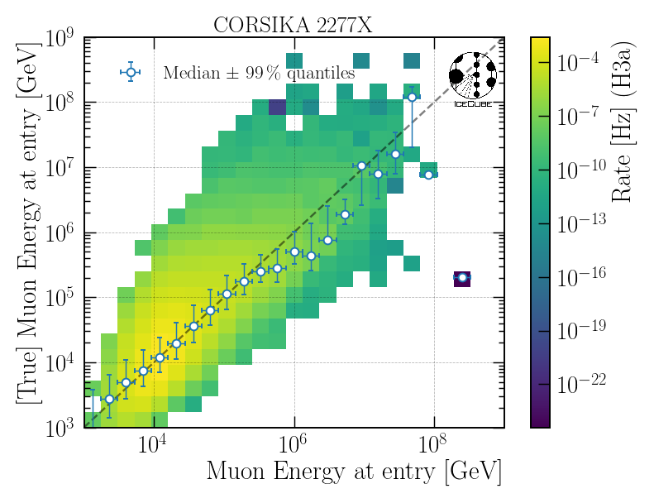
Reconstruction: High Energy Muons
DNN reconstruction of leading muon energy at detector entry
proxy variable in unfolding
IceCube Preliminary

Slide 8
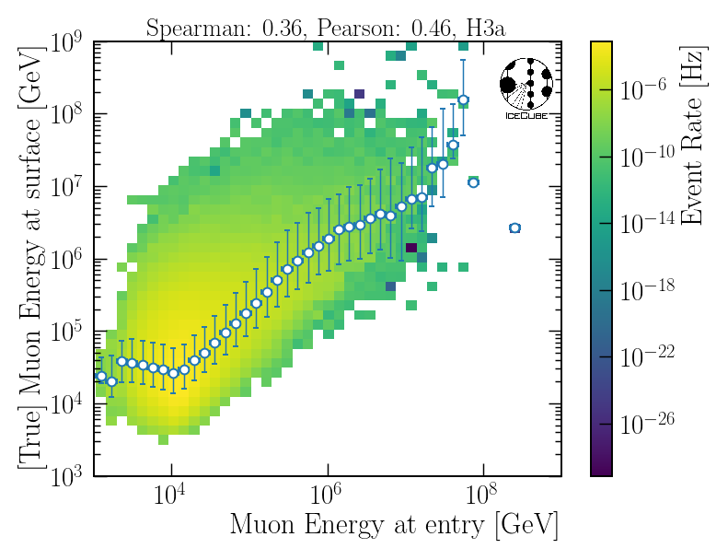
Proxy Variable: High Energy Muons
Correlation between proxy and target variable in unfolding
IceCube Preliminary

Slide 9
Data-MC: Stopping Muons

Slide 10
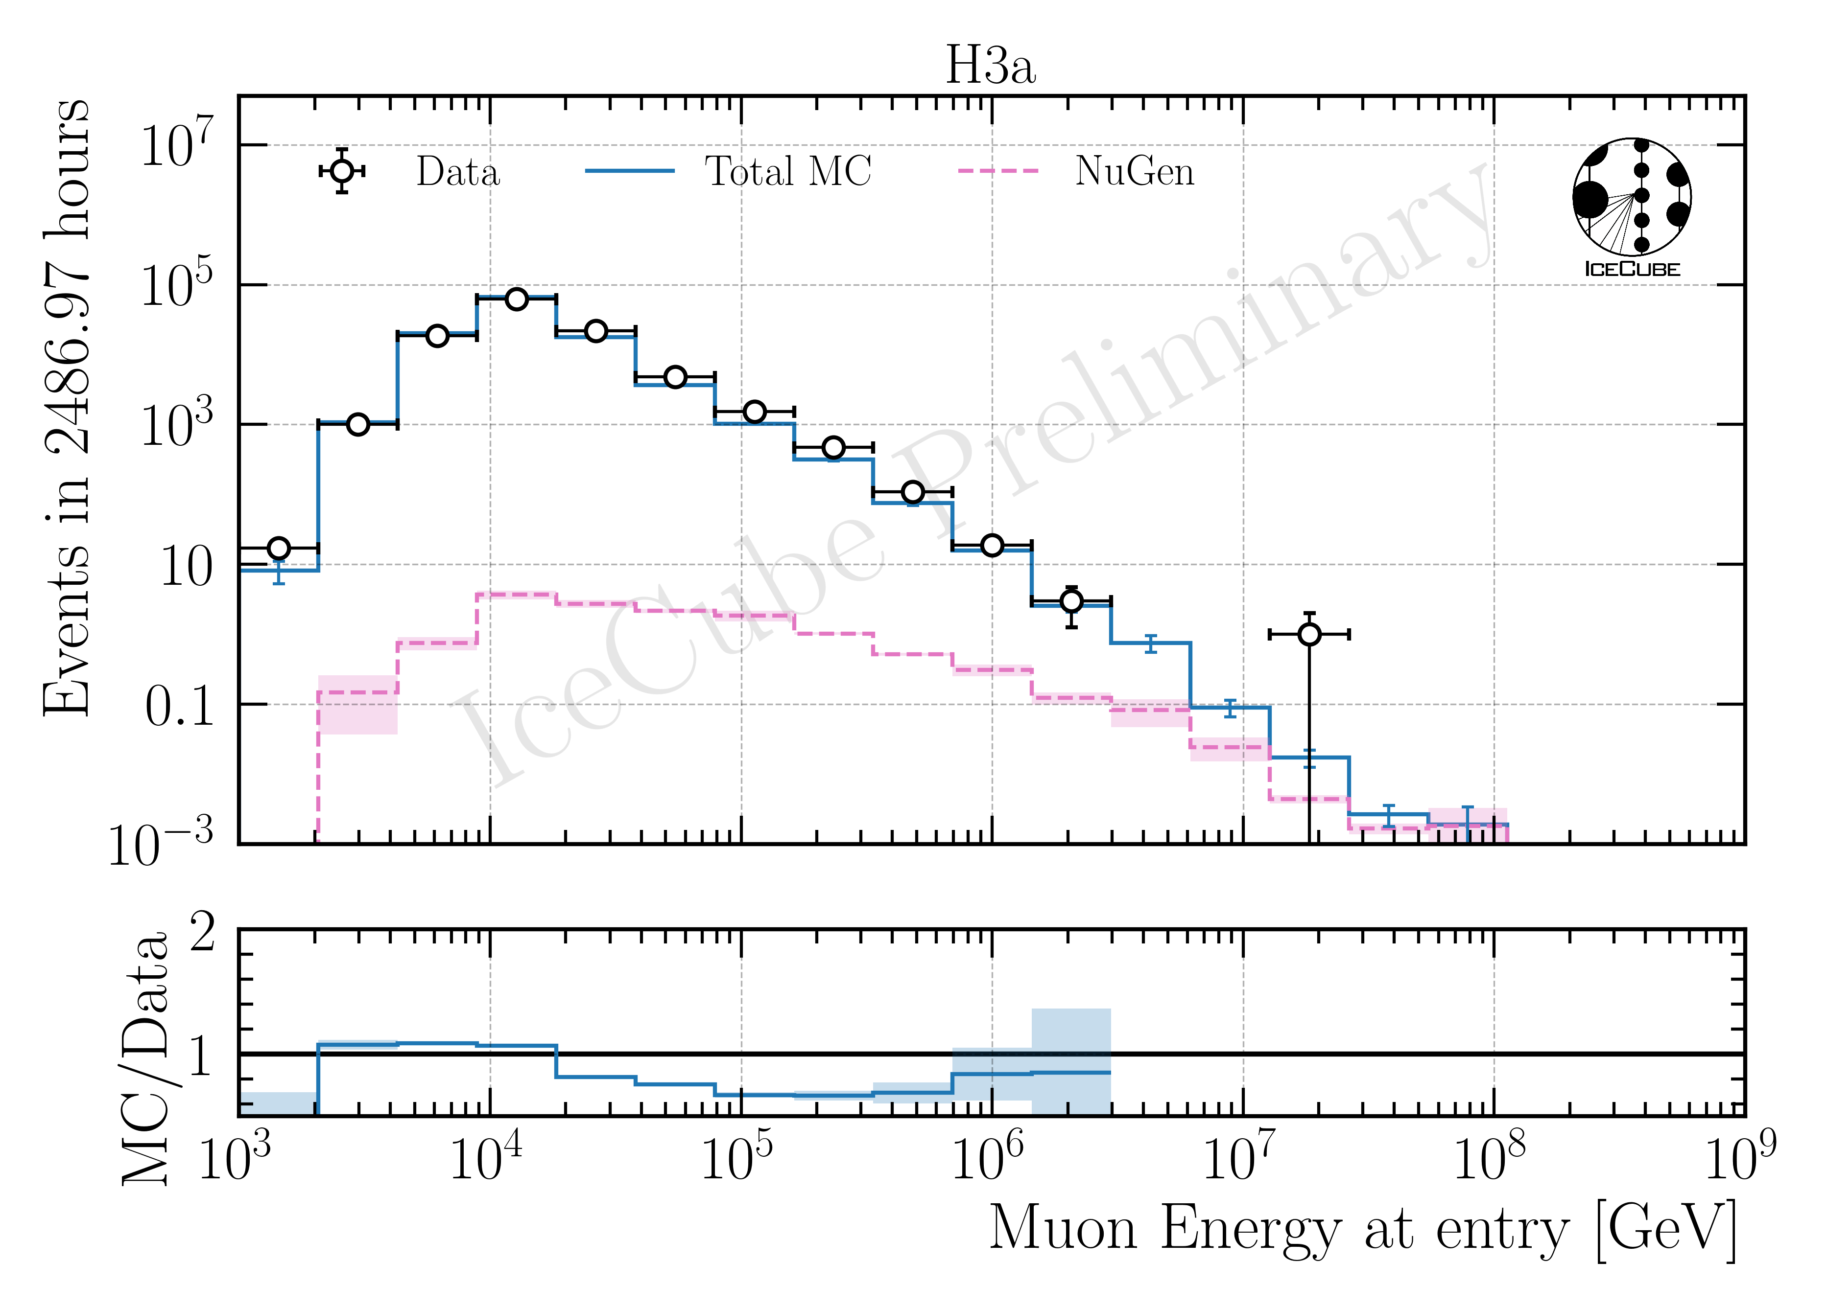
Data-MC: High Energy Muons

Slide 11
Robustness Stopping Muons

Slide 12
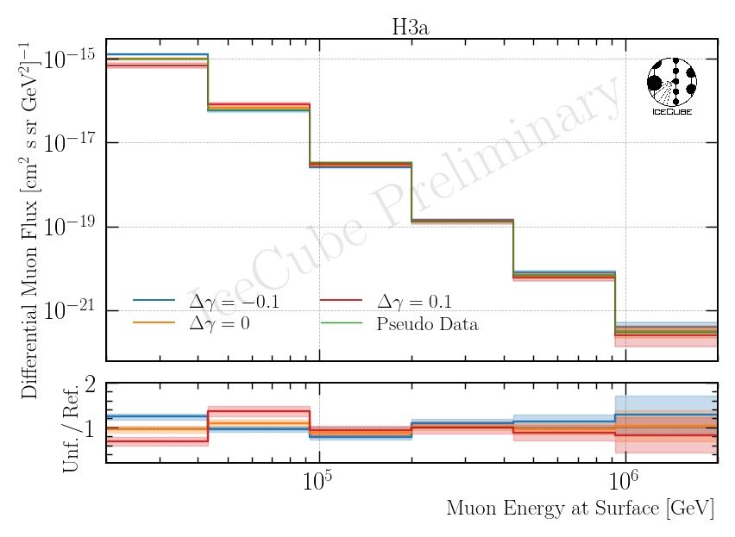
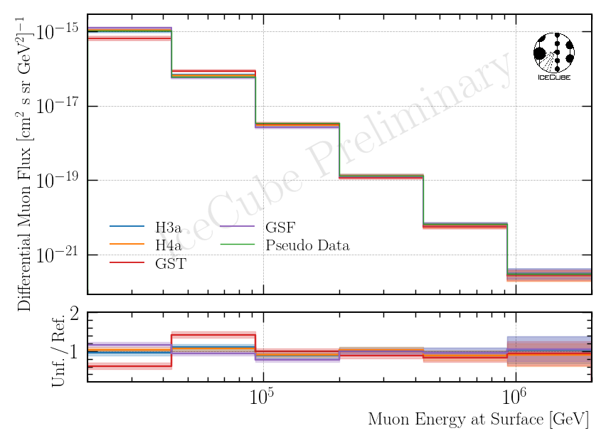
Robustness High Energy Muons – Starting at 20 TeV

Slide 13
Unfolding Propagation Length
Unfolding on burnsample

Slide 14
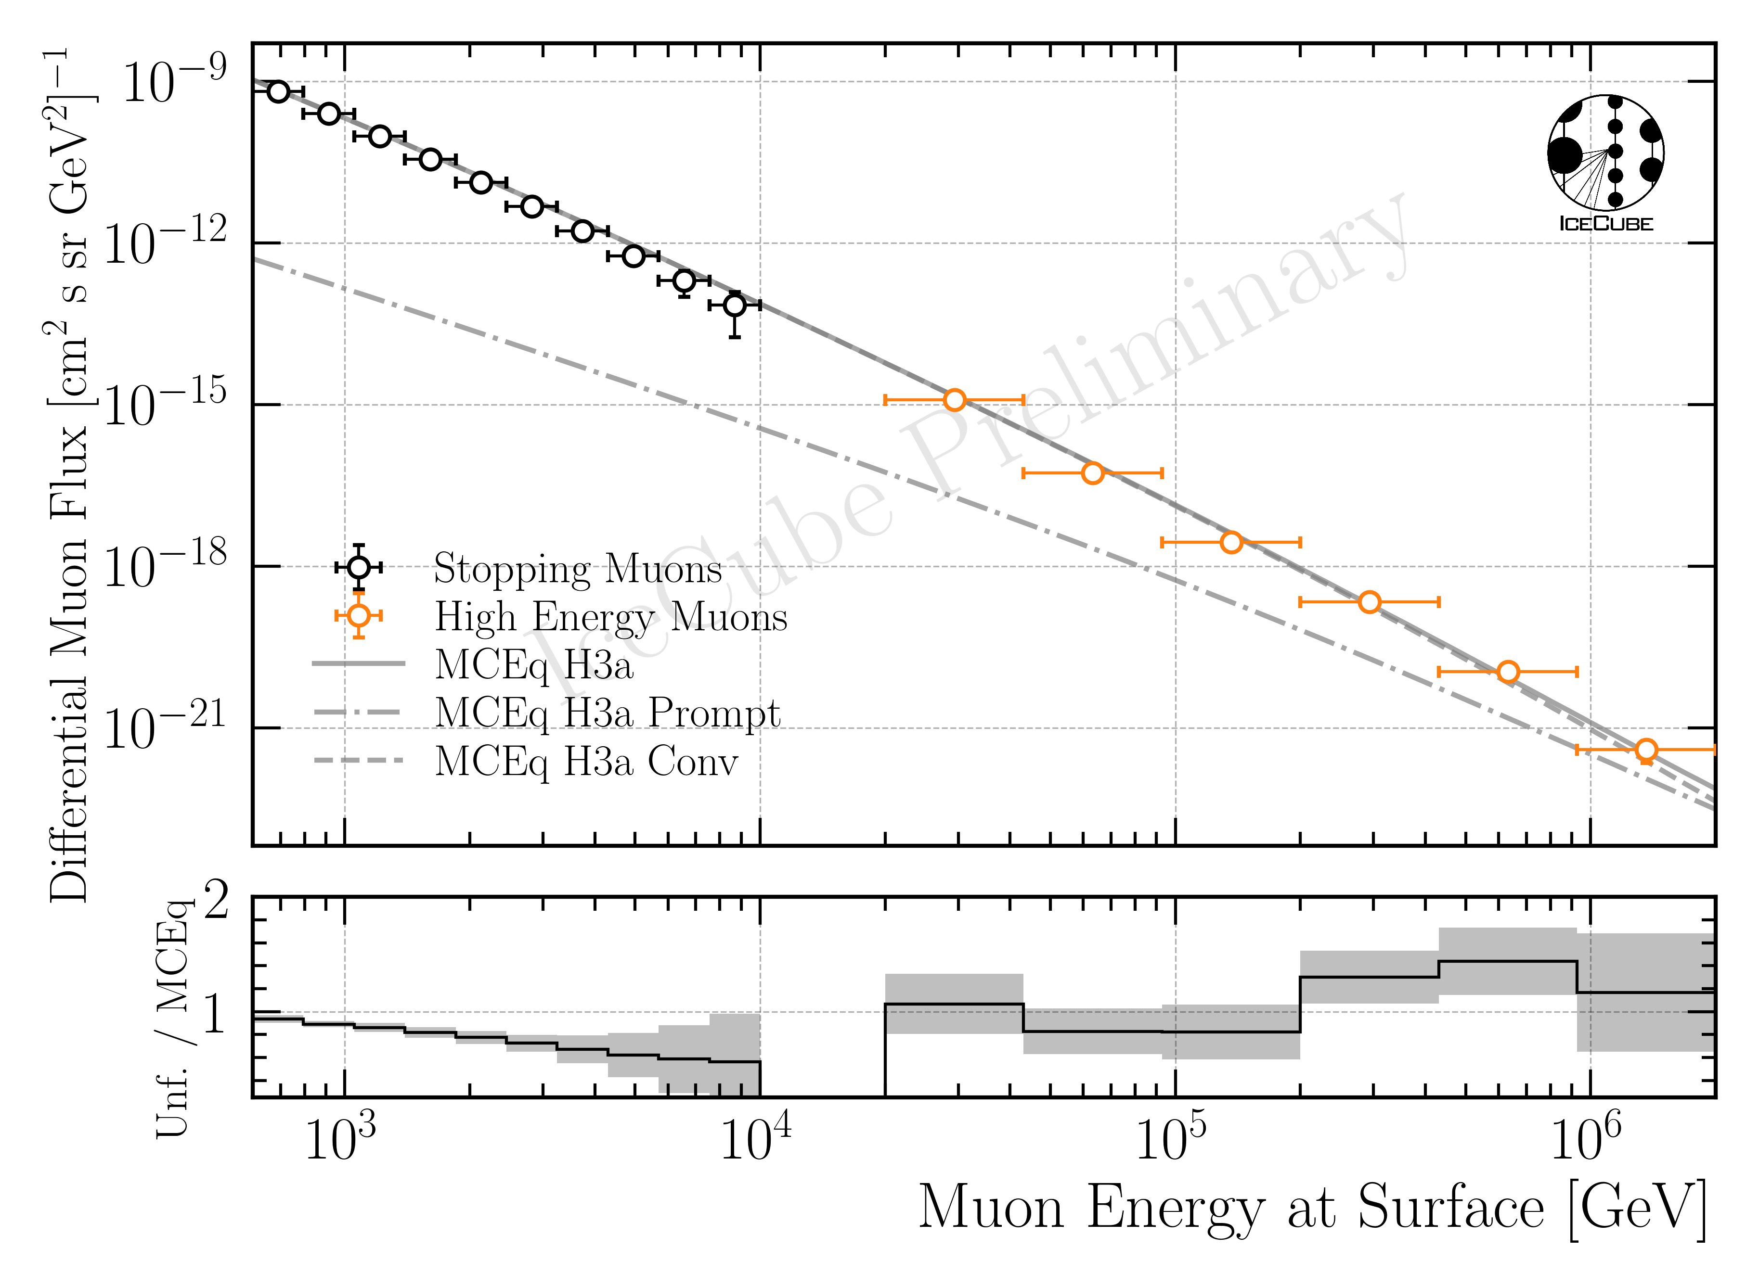
Unfolding Muon Flux
Both stopping muons and high energy muons show burnsample unfolding

Slide 15
Thank you for your comments

Slide 16
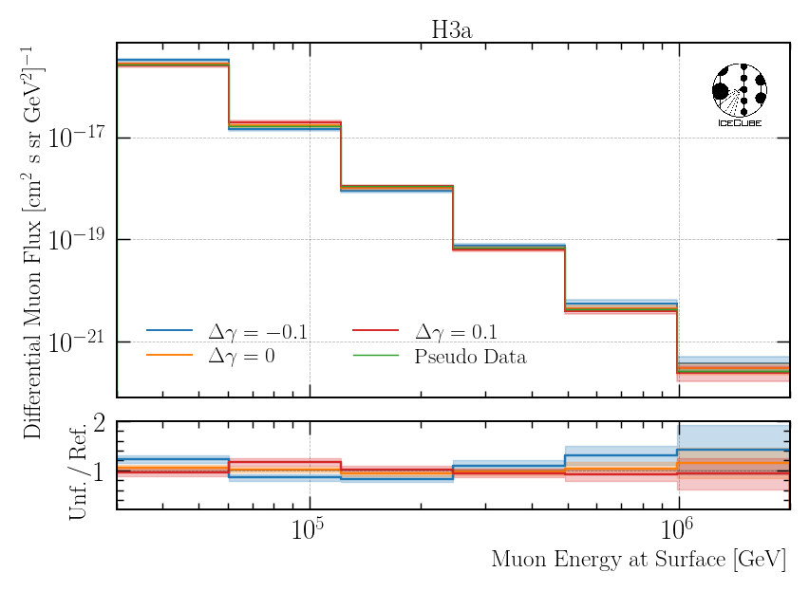
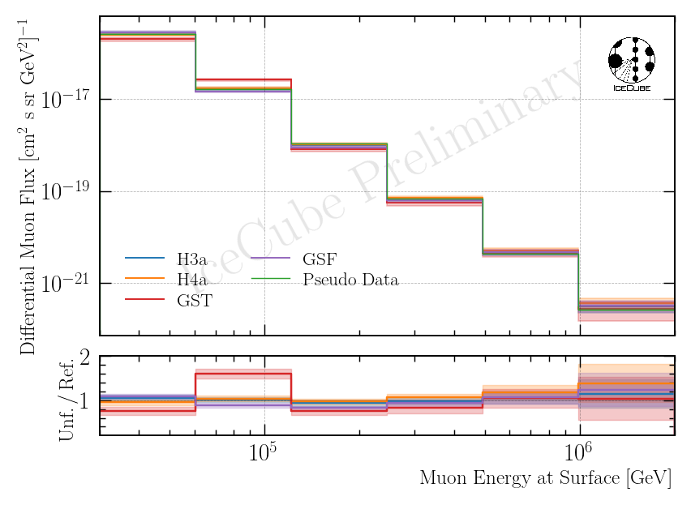
Robustness High Energy Muons – Starting at 30 TeV
IceCube Preliminary

Slide 17
Analysis Goals: Detect Prompt Muons
Unfold a muon energy spectrum at surface
Measure prompt component of the atmospheric muon flux
Most energetic muon in bundle
Muon parent:
pion or kaon
yes
no
conventional
prompt
Definition leading muon:
most energetic muon of a muon bundle
Credit: Ludwig Neste

Slide 18
Overview
Analysis
Simulation
Reconstruction
Selection
Forward fit
Run as separate
analysis
Dataset
CORSIKA 77500 Ehist
SIBYLL 2.3d
10 TeV – 100 EeV
DNN reconstructions
Muon energies
Muon direction
Track geometry
Level 3
L2 muon filter
500 TeV bundle energy cut at surface
Add labels
Fit prompt normalization
Poisson LLH fit
Focus on today
Validation
Tag prompt / conv particles
MCEq comparisons
Unfolding
Level 4
Add DNN reconstructions
Muon spectrum
Unfold muon flux
Level 5
Data-MC quality cuts

Slide 19
Investigate Neutrino Background

Slide 20
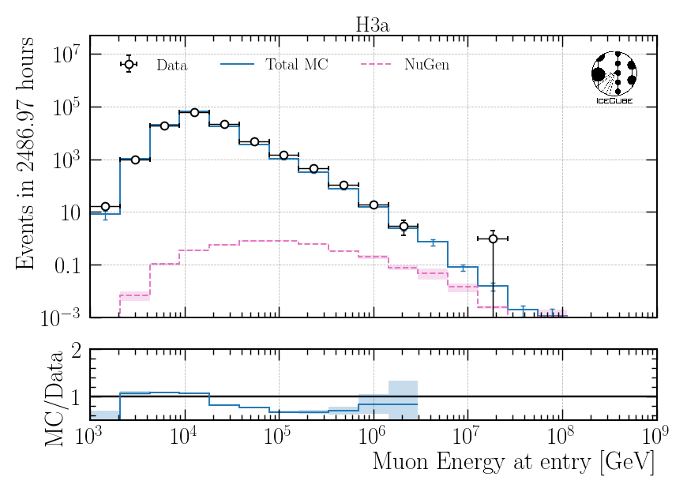

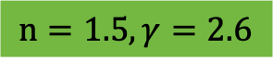
Impact of Astrophysical Neutrinos – Muon Energy at Entry
$$n=1.5, γ=2.6$$
NuGen: only astro
NuGen: atmospheric and astro
Neutrinos contribute ~10% to total flux at high energies > 5 PeV

Slide 21
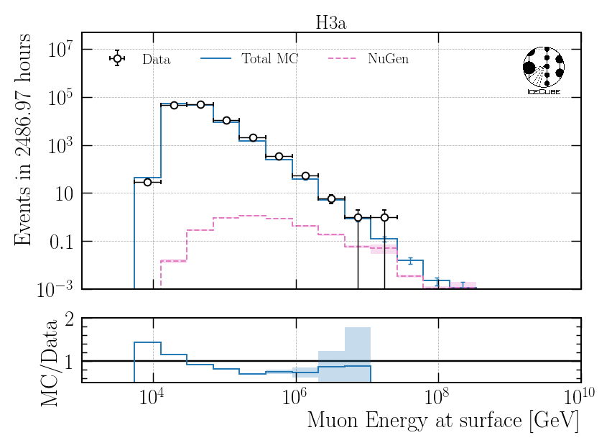
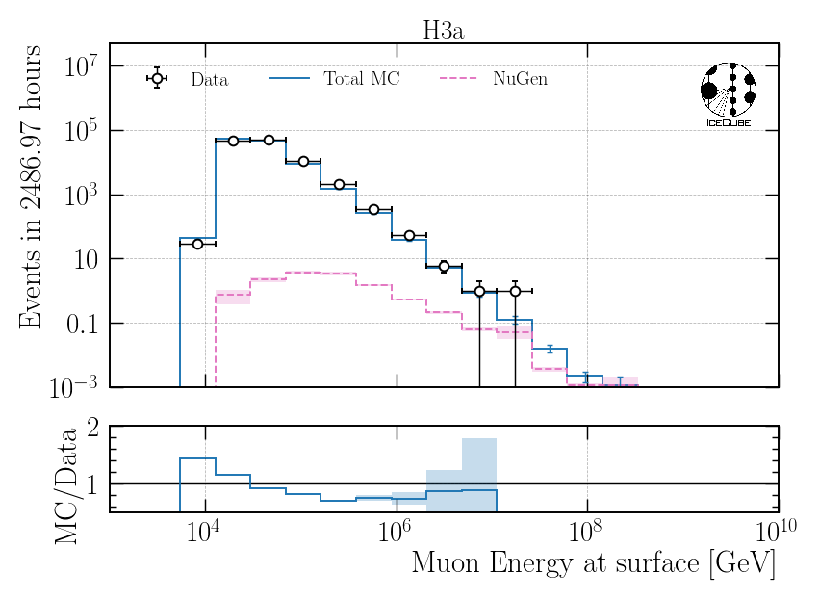
Impact of Astrophysical Neutrinos – Muon Energy at Surface
$$n=1.5, γ=2.6$$
NuGen: only astro
NuGen: atmospheric and astro
Neutrinos contribute ~50% to total flux at high energies > 5 PeV

Slide 22
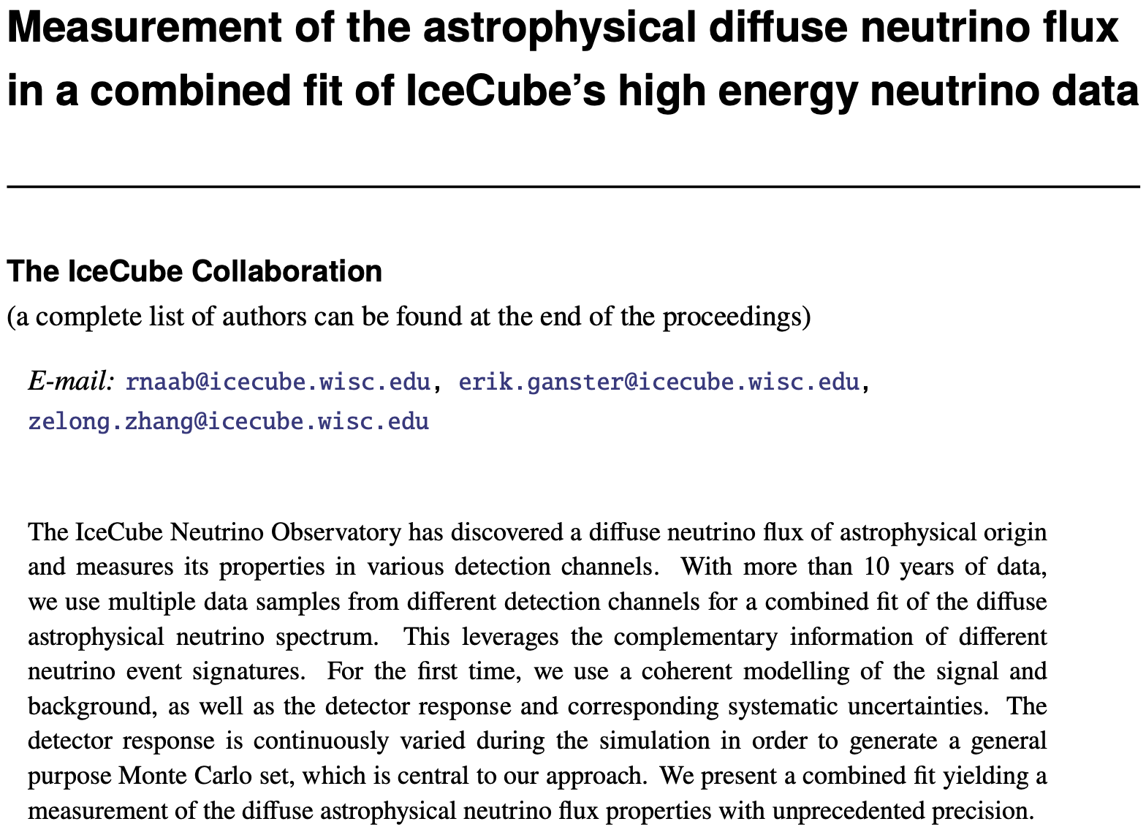
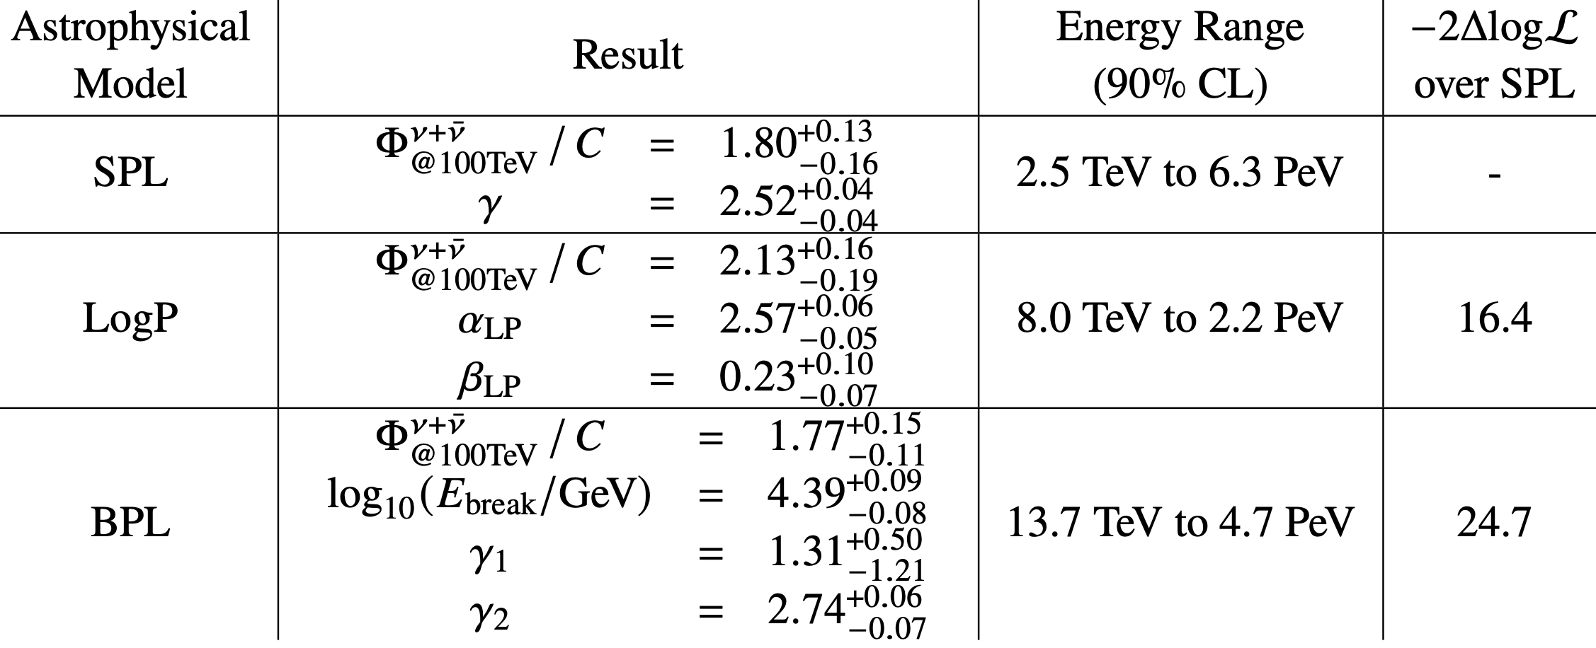
Assume Latest Astrophysical Diffuse Results by IceCube
ArXiv: 2308.00191
Test SPL and BPL

Slide 23
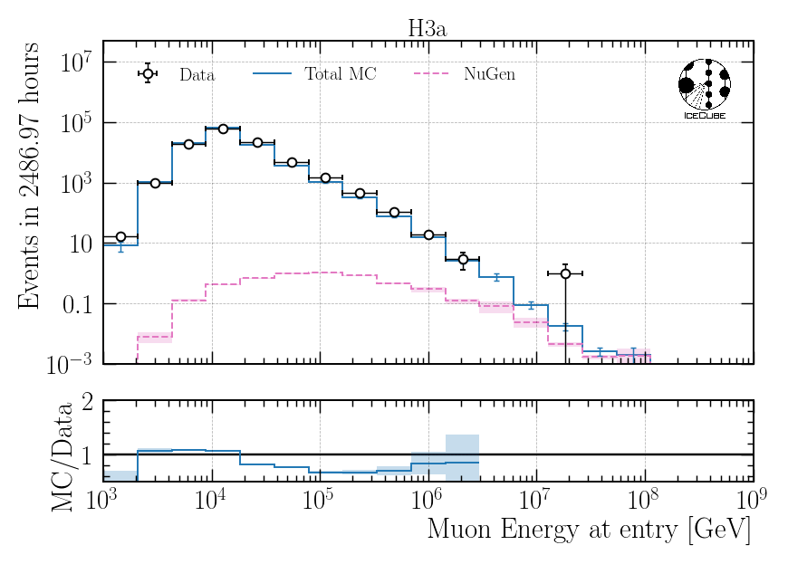

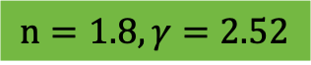
Impact of Astrophysical Neutrinos – Muon Energy at Entry
$$n=1.8, γ=2.52$$
2308.00191
NuGen: only astro
NuGen: atmospheric and astro
Neutrinos contribute ~10% to total flux at high energies > 5 PeV

Slide 24
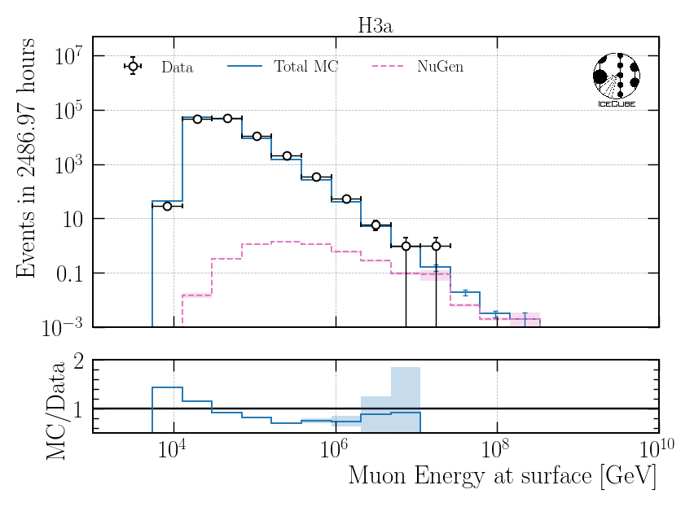
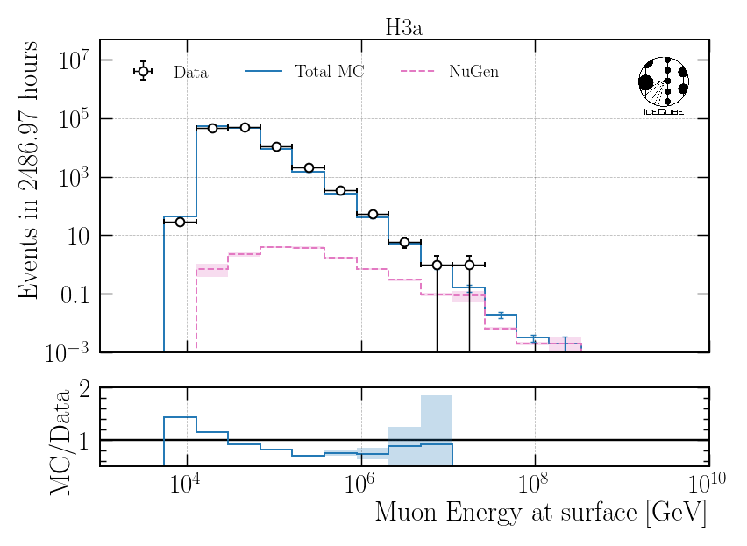
Impact of Astrophysical Neutrinos – Muon Energy at Surface
$$n=1.8, γ=2.52$$
2308.00191
NuGen: only astro
NuGen: atmospheric and astro
Neutrinos contribute ~50% to total flux at high energies > 5 PeV

Slide 25
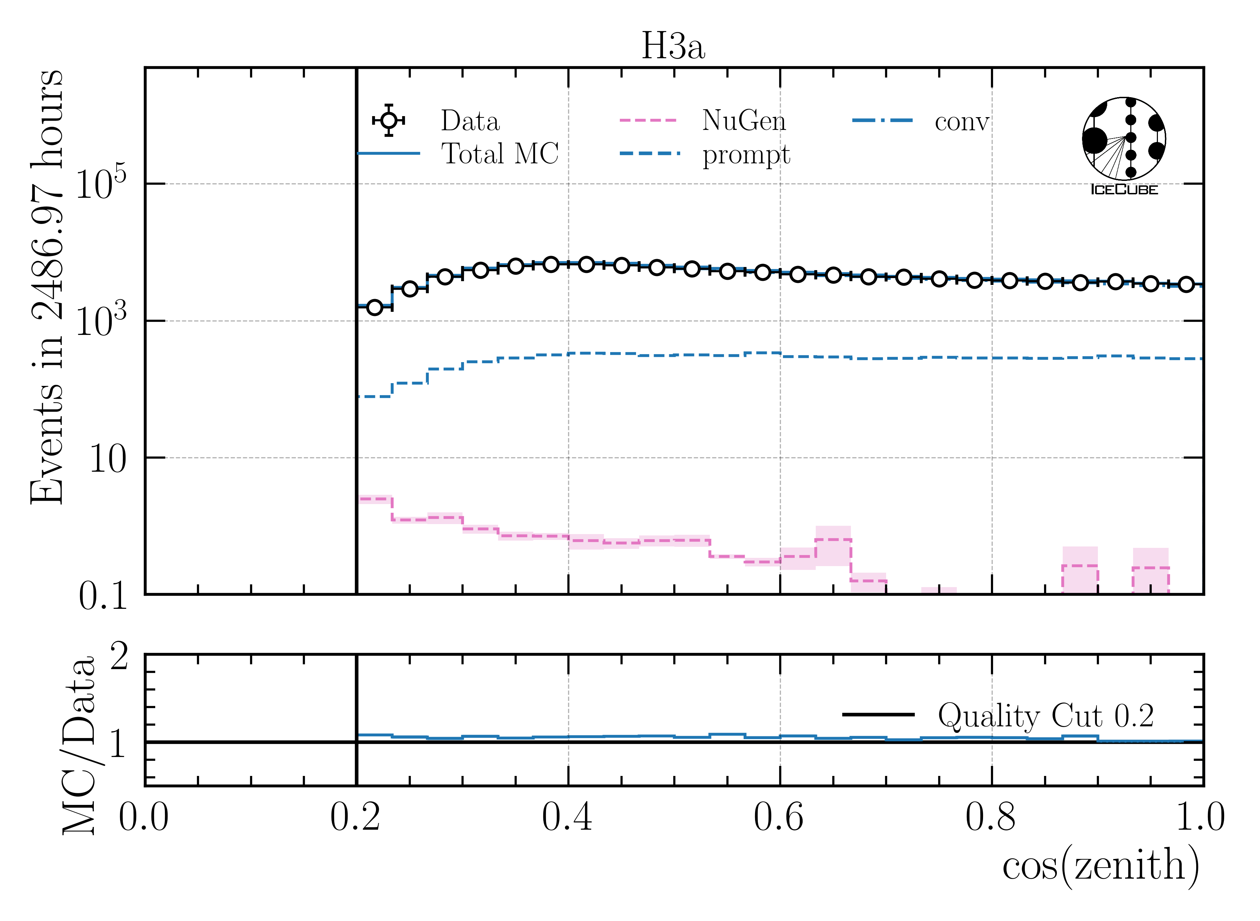
Cos(zenith) Distribution
Expect more neutrinos from the horizon
Apply stronger zenith cut to remove neutrinos
horizontal
vertical

Slide 26
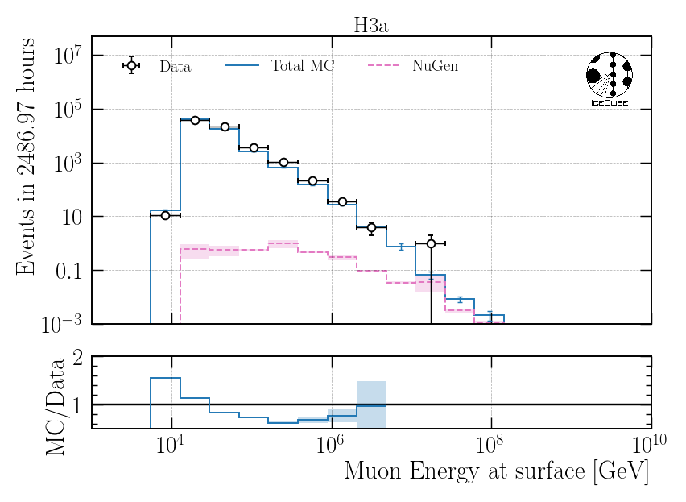
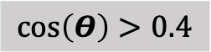
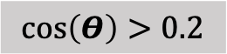
Remove Horizontal Events – Muon Energy at Surface
$$n=1.8, γ=2.52$$
2308.00191
NuGen: atmospheric and astro
NuGen: atmospheric and astro
$$\cos\left(Θ\right)>0.2$$
$$\cos\left(Θ\right)>0.4$$
Stronger zenith cut has no significant impact

Slide 27
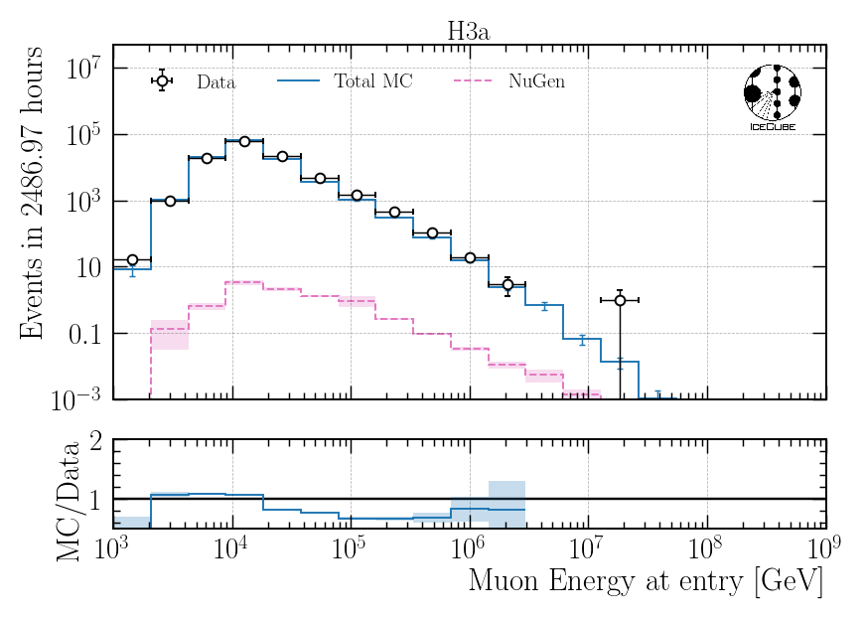
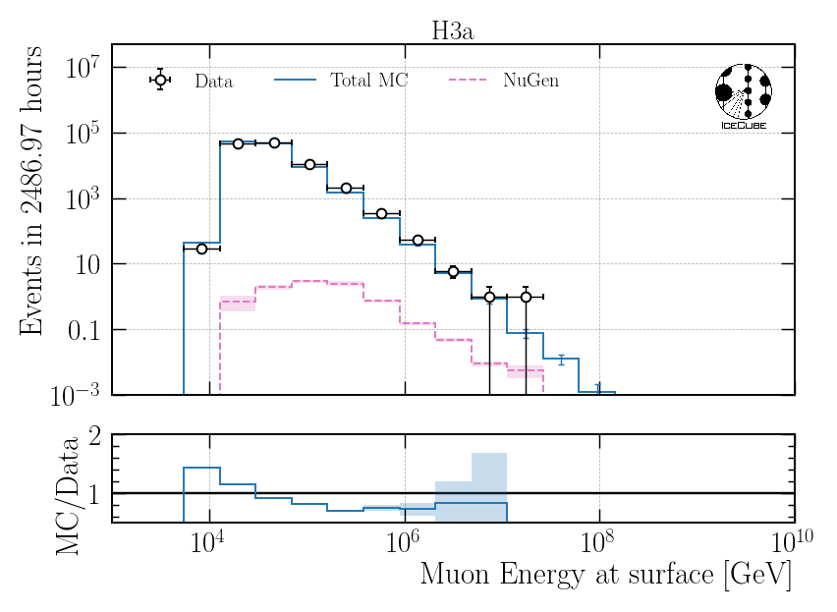
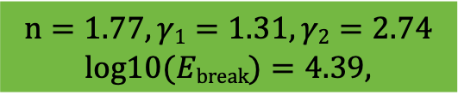
Impact of Astrophysical Neutrinos – Muon Energy at Surface/Entry
NuGen: atmospheric and astro
NuGen: atmospheric and astro
$$n=1.77, γ1=1.31,γ2=2.74$$
$$log10(Ebreak)=4.39,$$
For BPL: Neutrinos contribute less than 10%
2308.00191

Slide 28
Z—Vertex Data-MC
Networks were trained on several old CORSIKA simulation datasets to make them robust
Re-train on new ice model spice_ftp-v3m

Slide 29
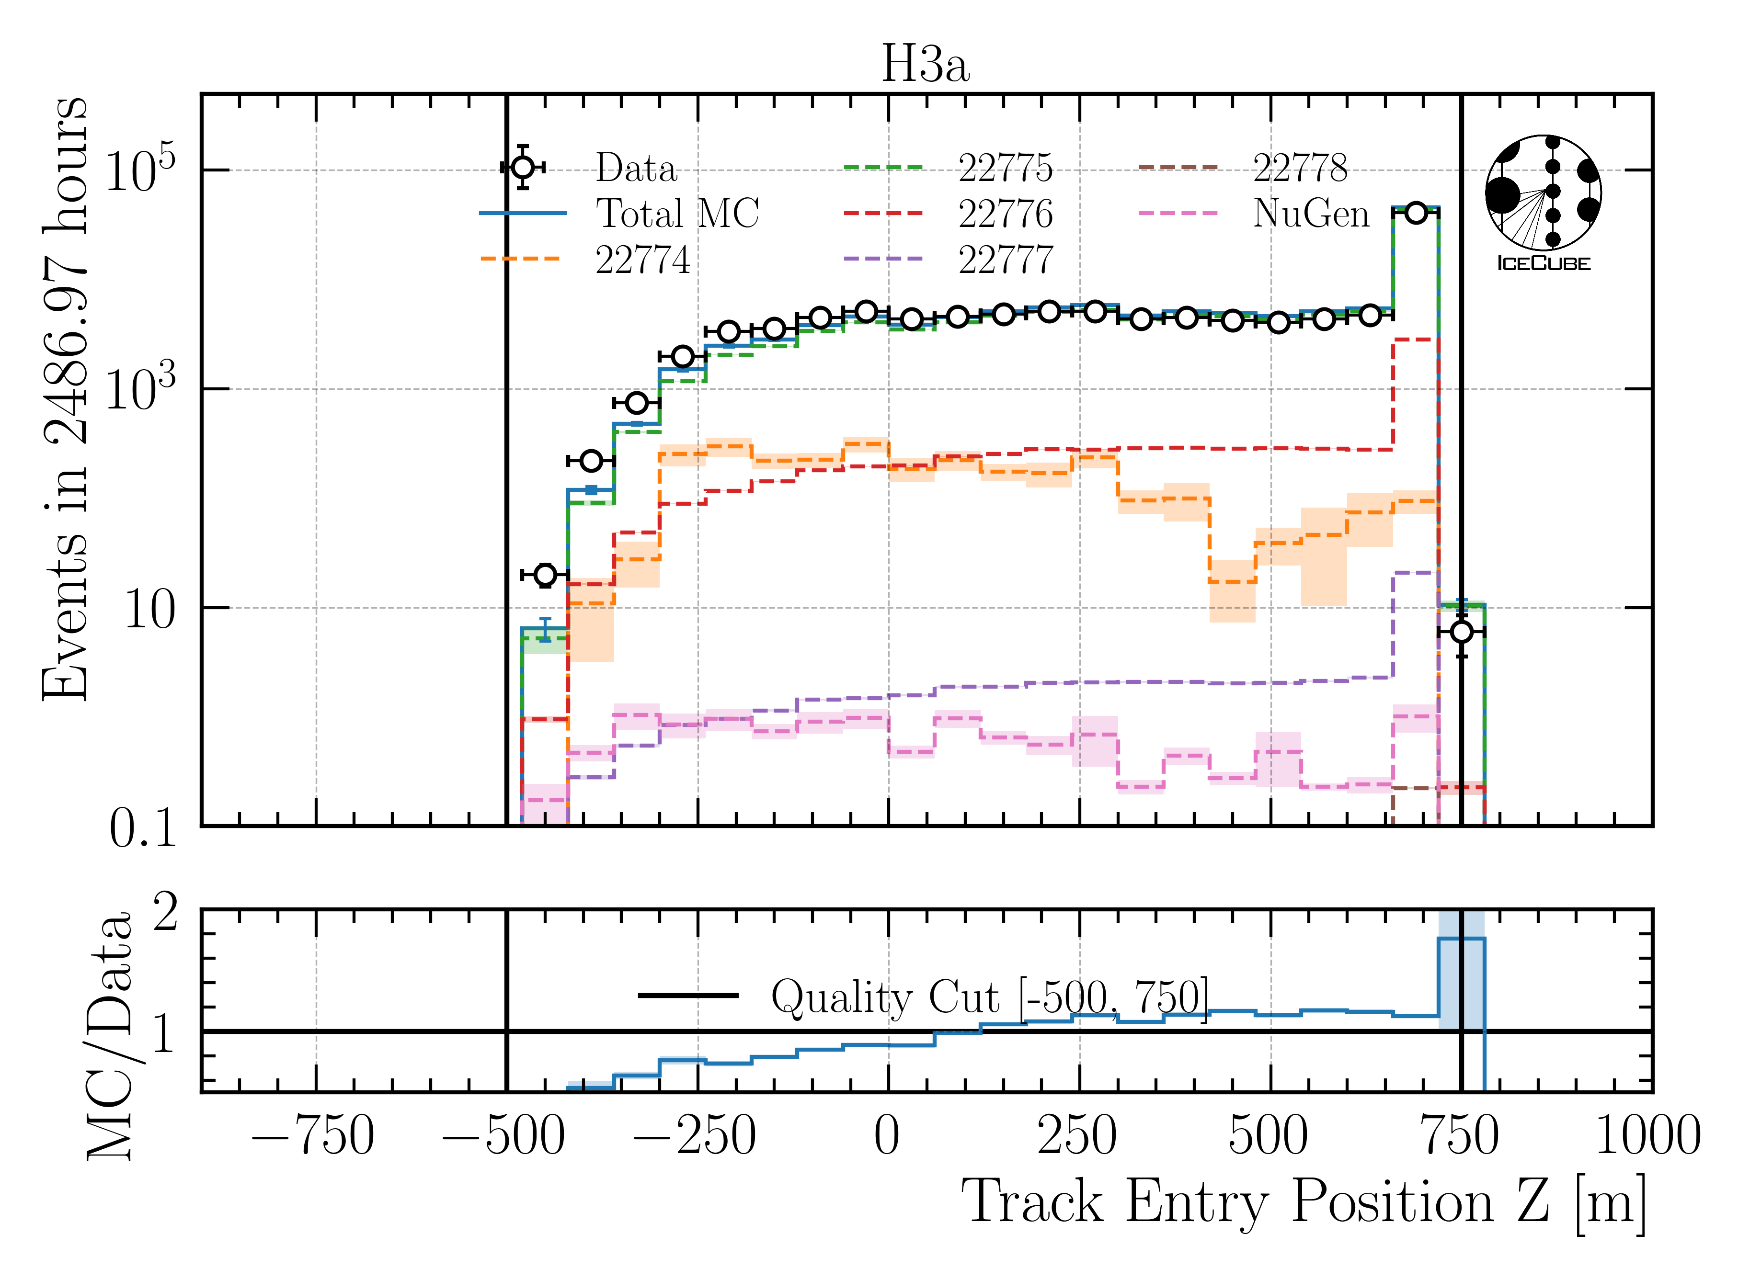
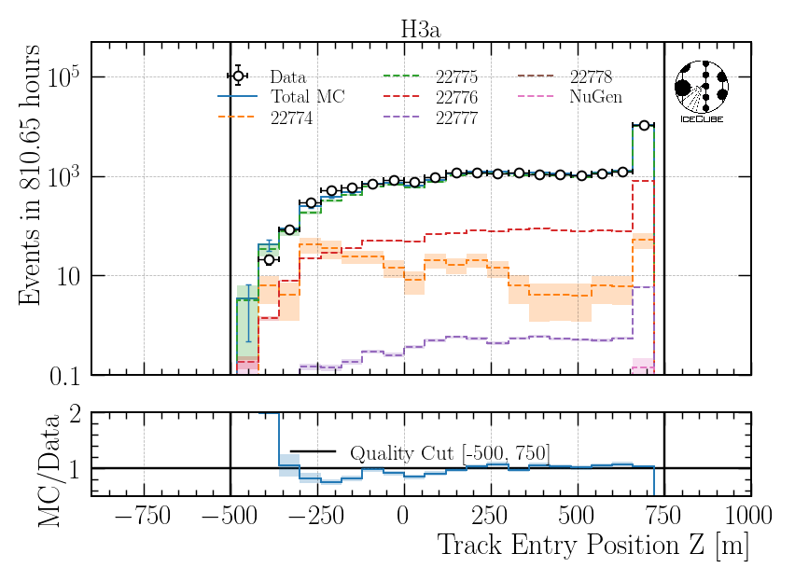
Z—Vertex Data-MC: Entry Position
Old ice model
New ice model

Slide 30
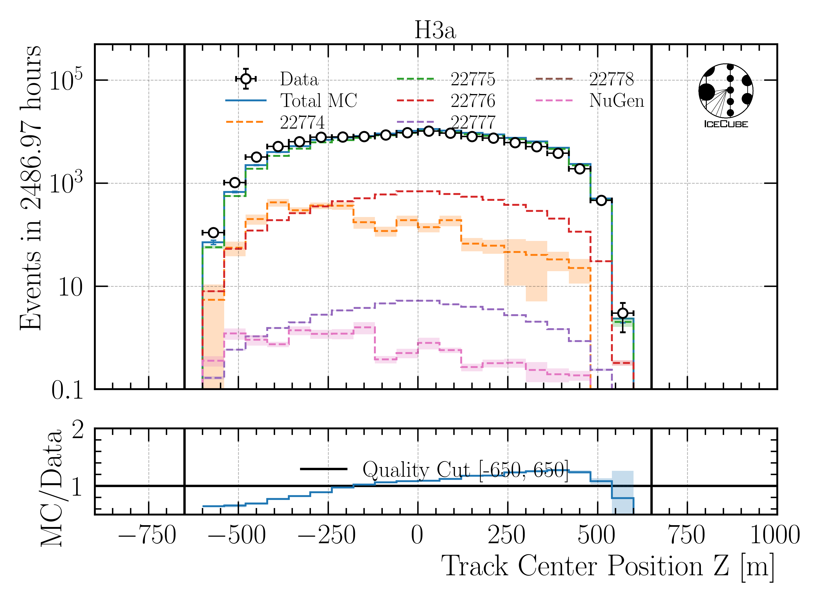
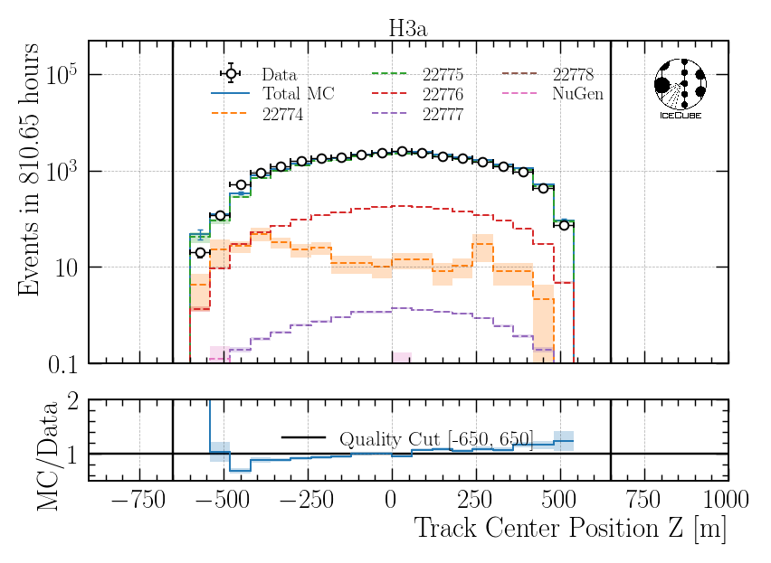
Z—Vertex Data-MC: Center Position
Old ice model
New ice model

Slide 31
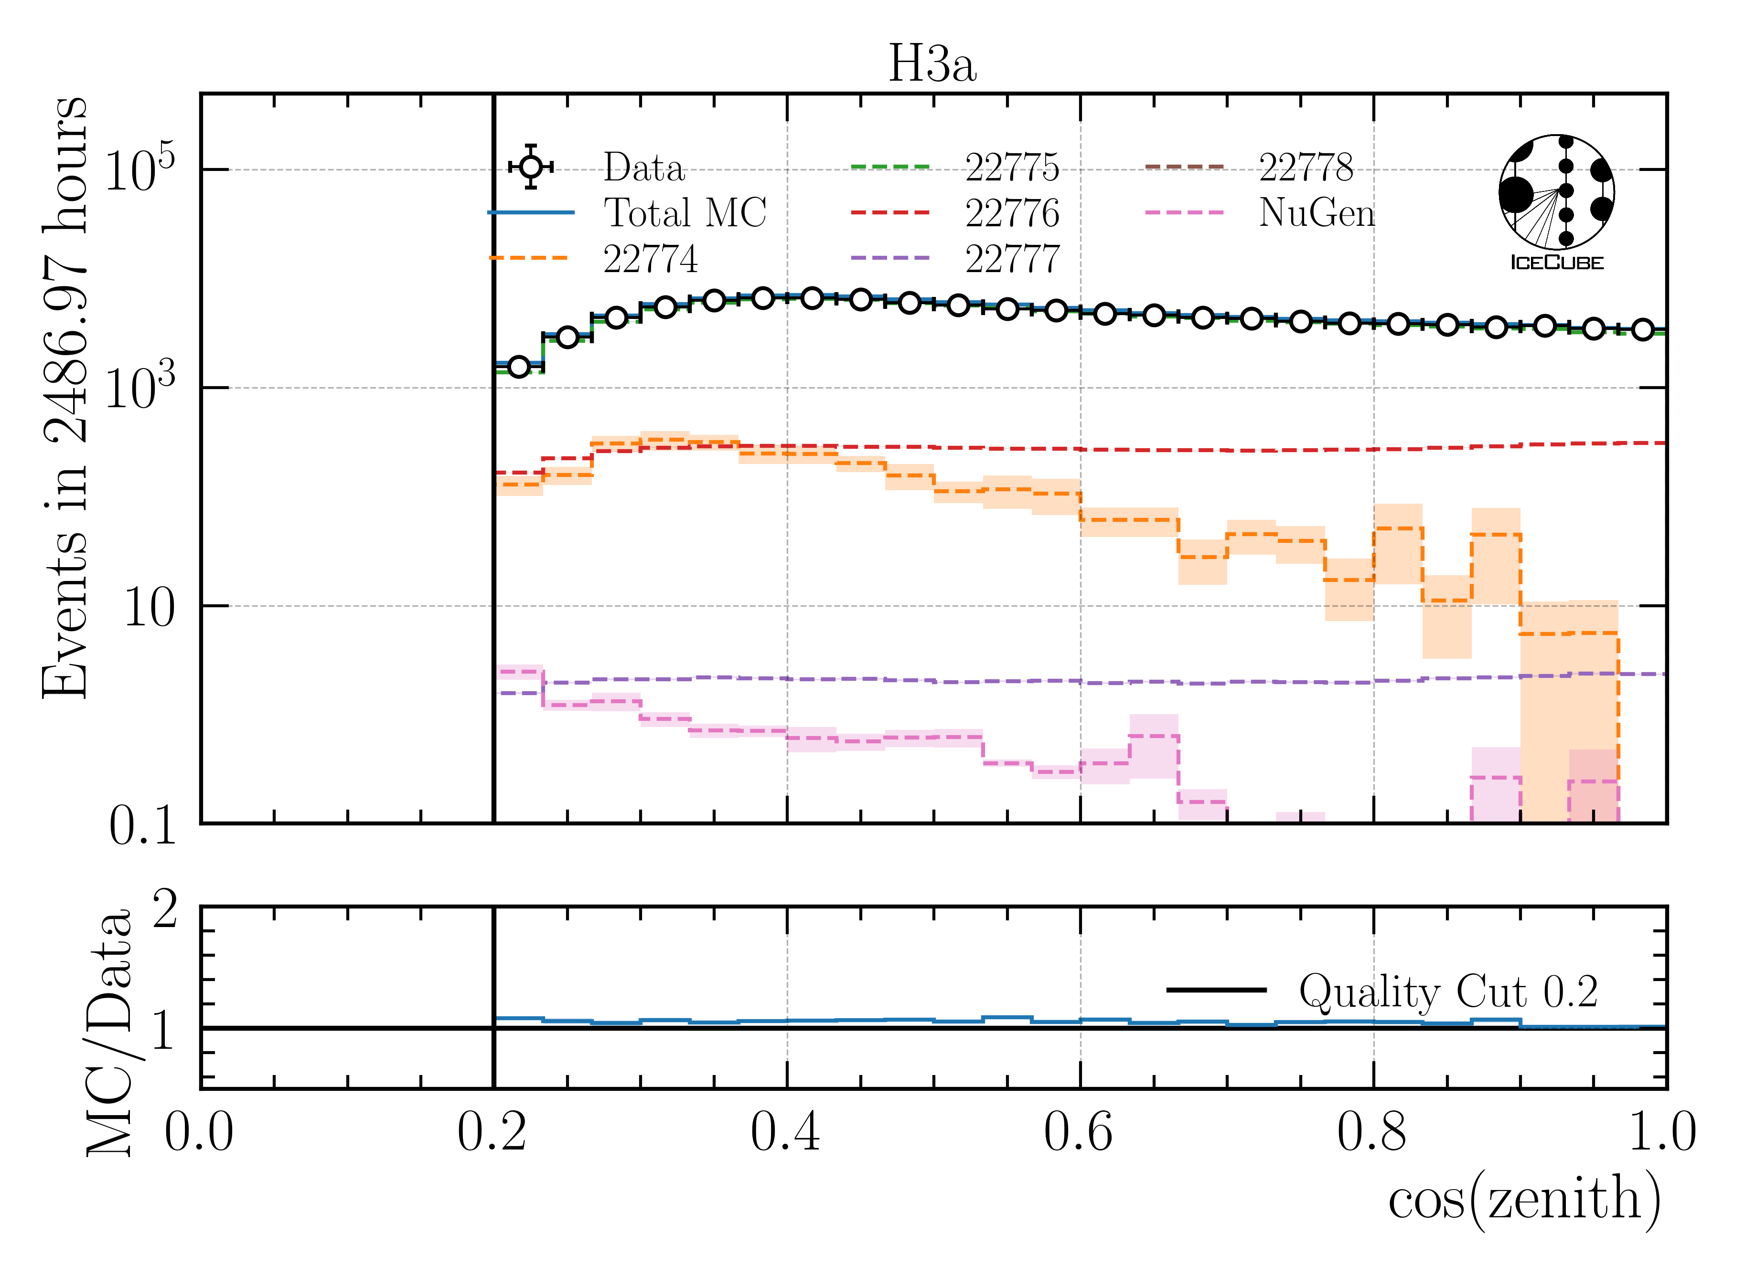
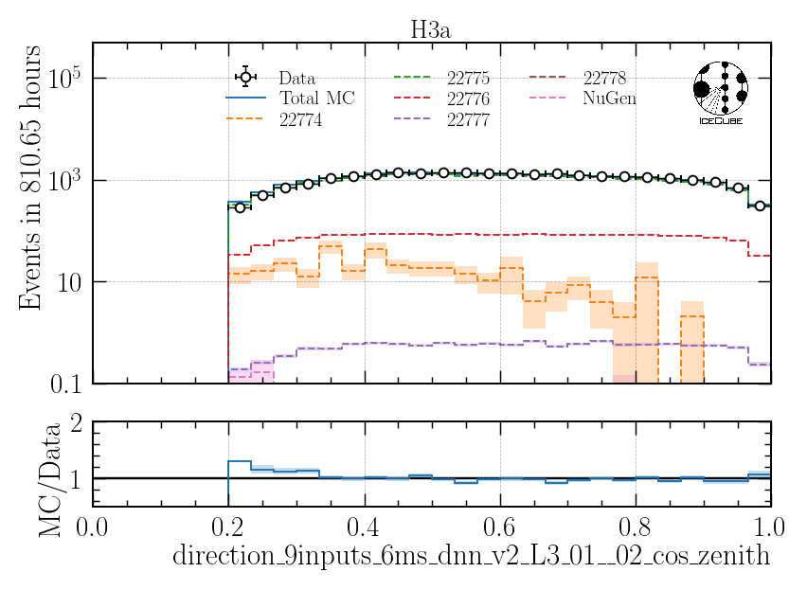
Cos(zenith)
Old ice model
New ice model
Artefacts observed in zenith reconstruction
Re-train zenith reco network

Slide 32
Include Systematic Uncertainties on Effective Area

Slide 33
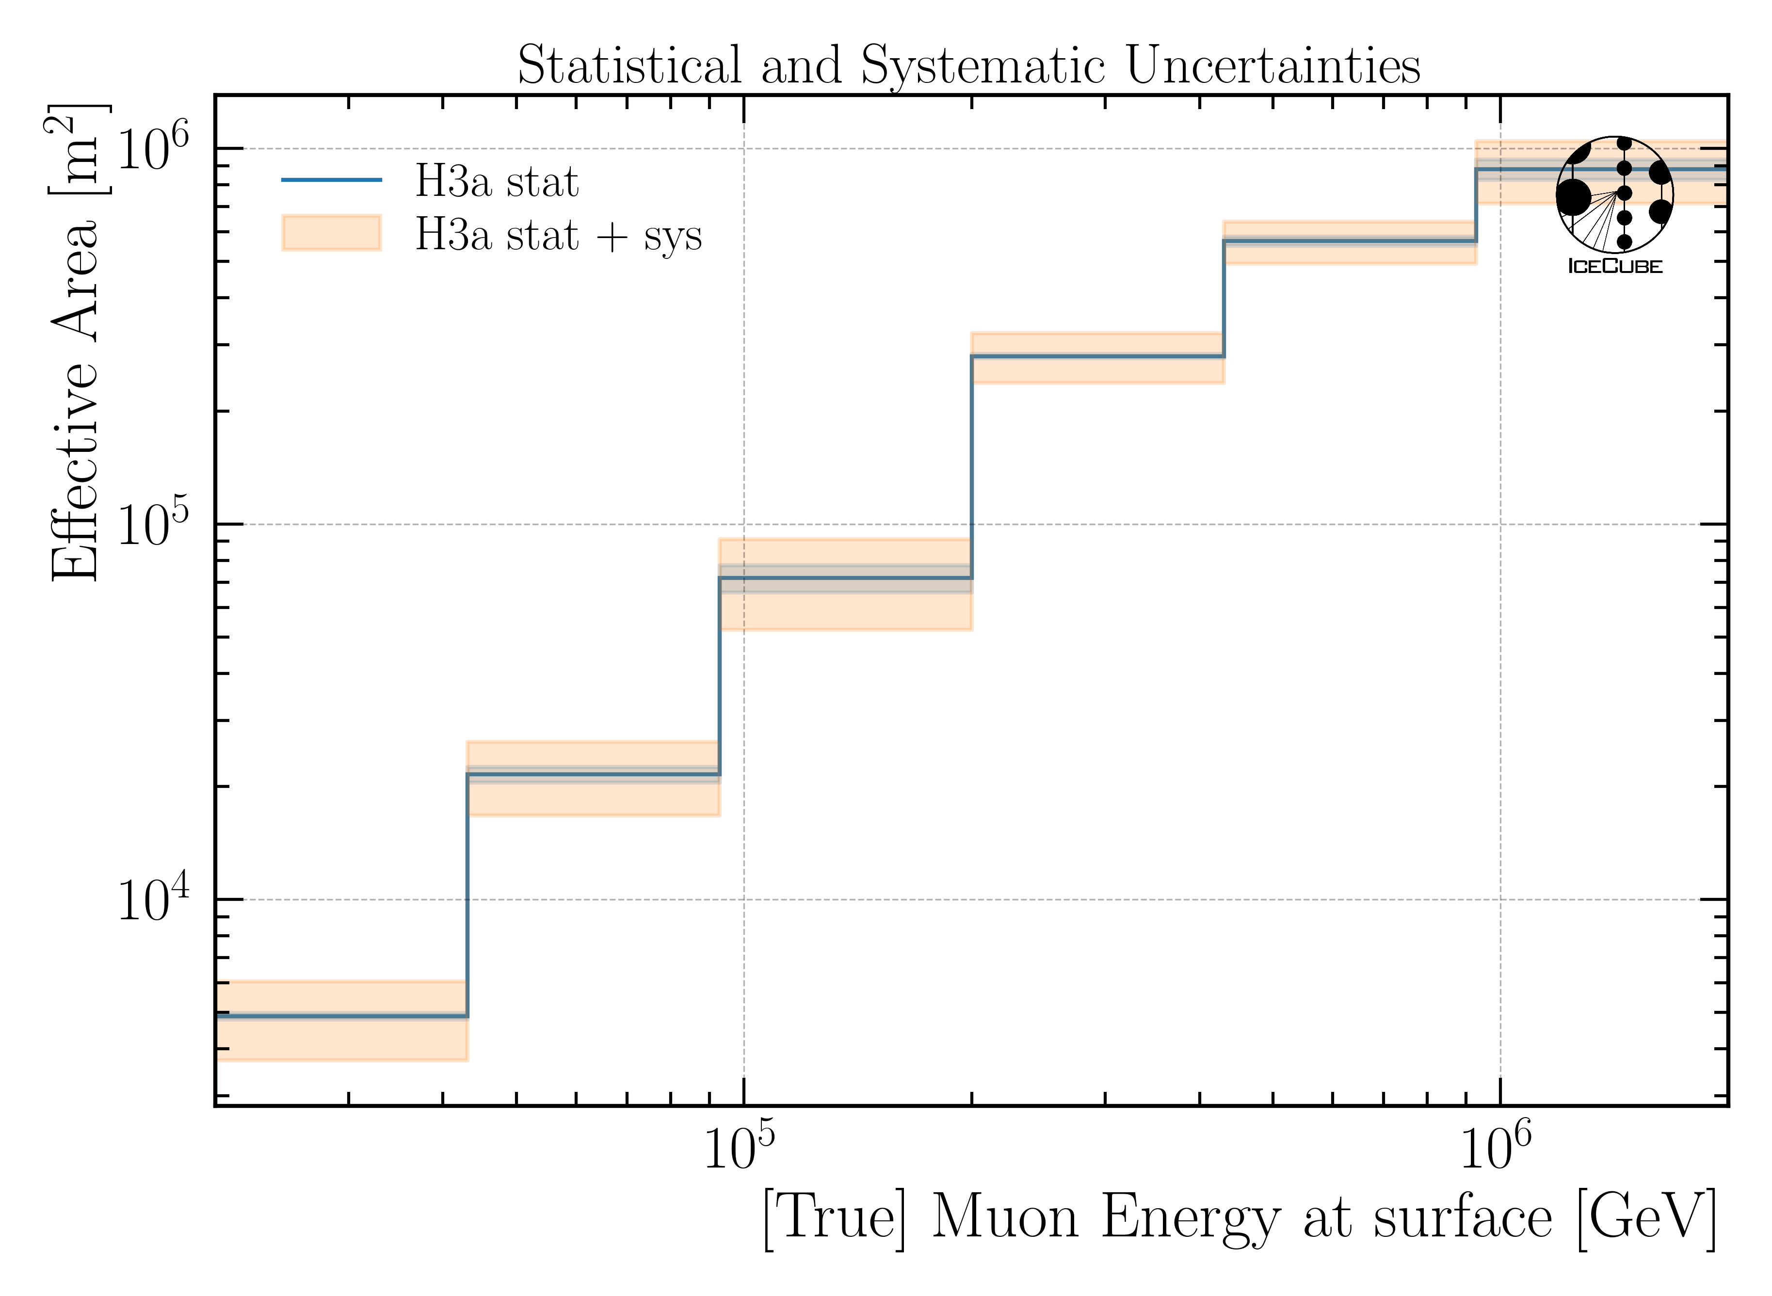
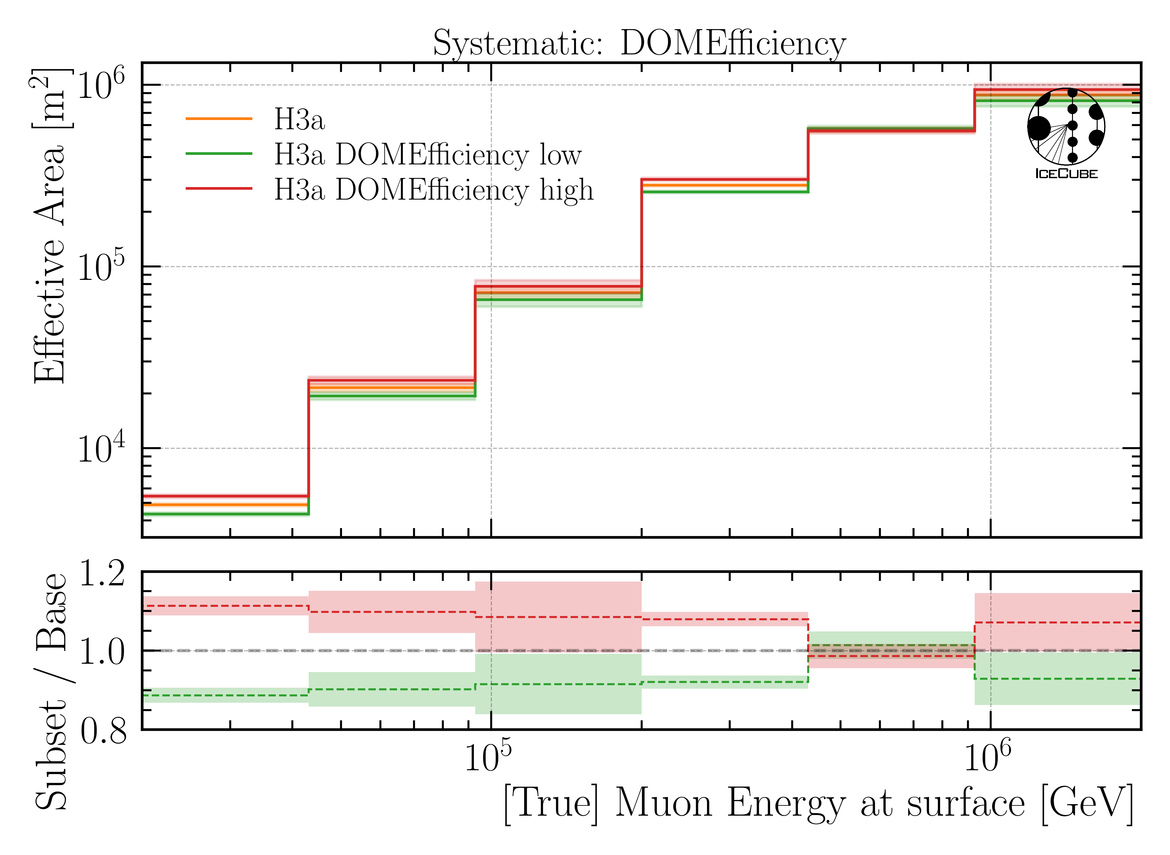
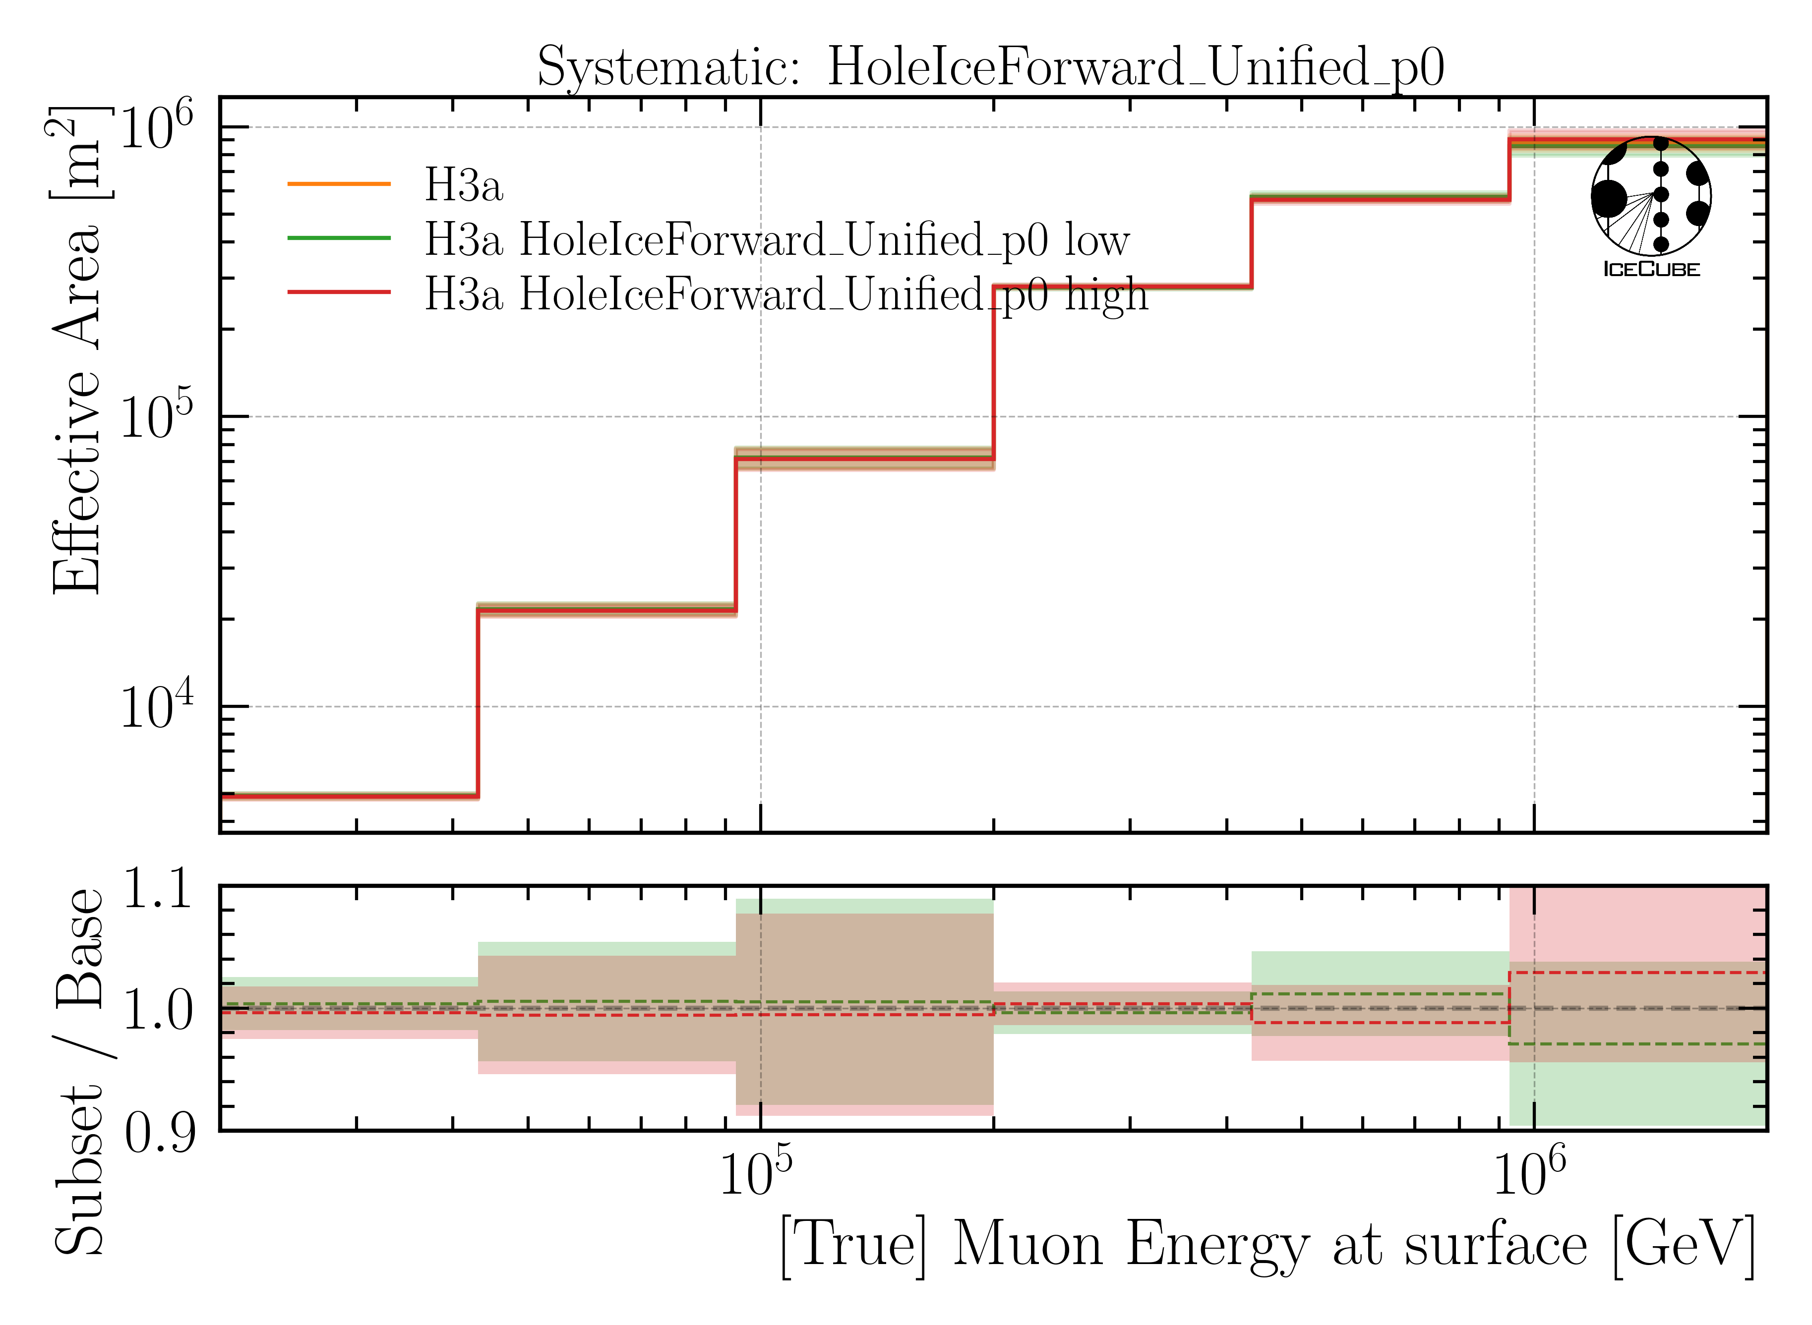
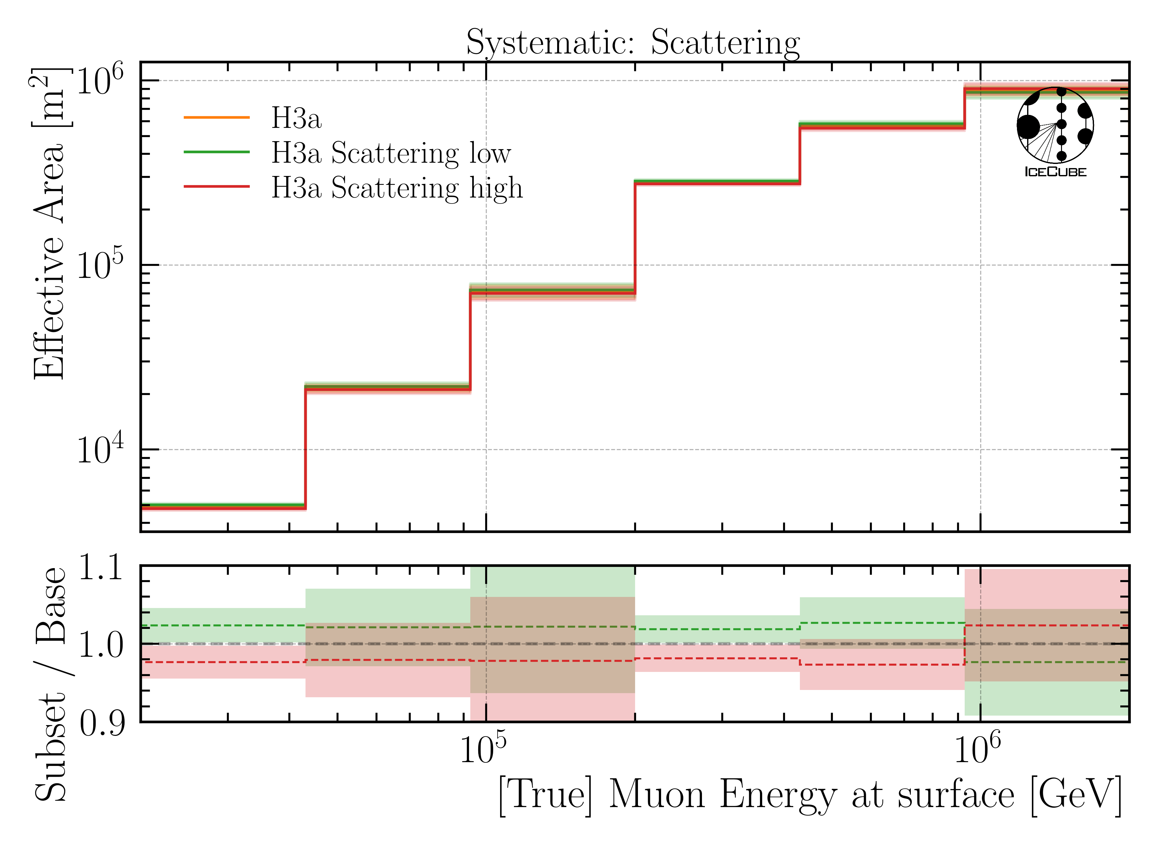
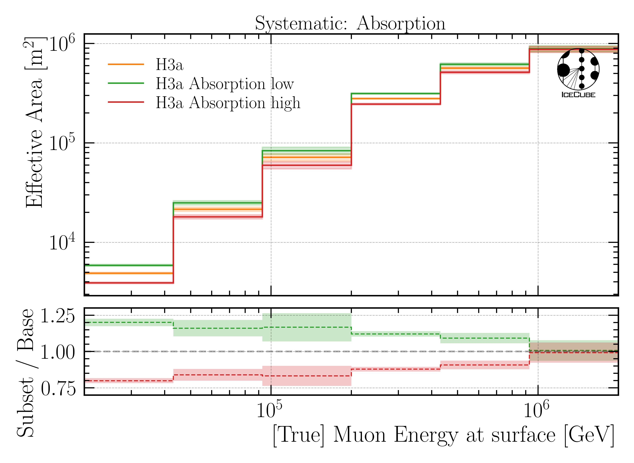
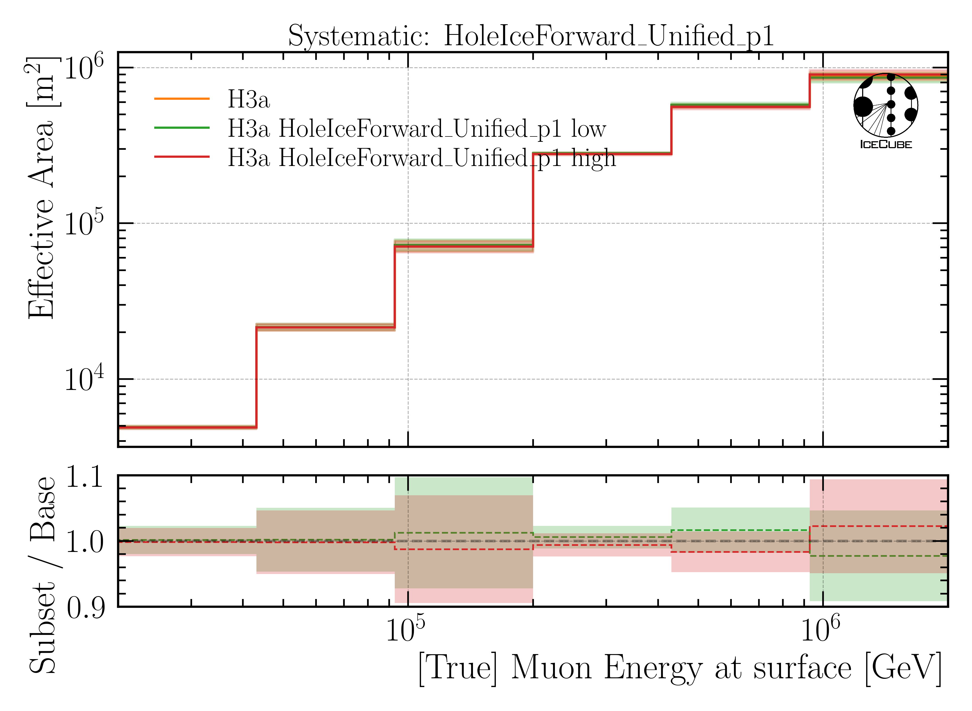
Effective Area
Baseline: entire set
Subset: above/below median

Slide 34
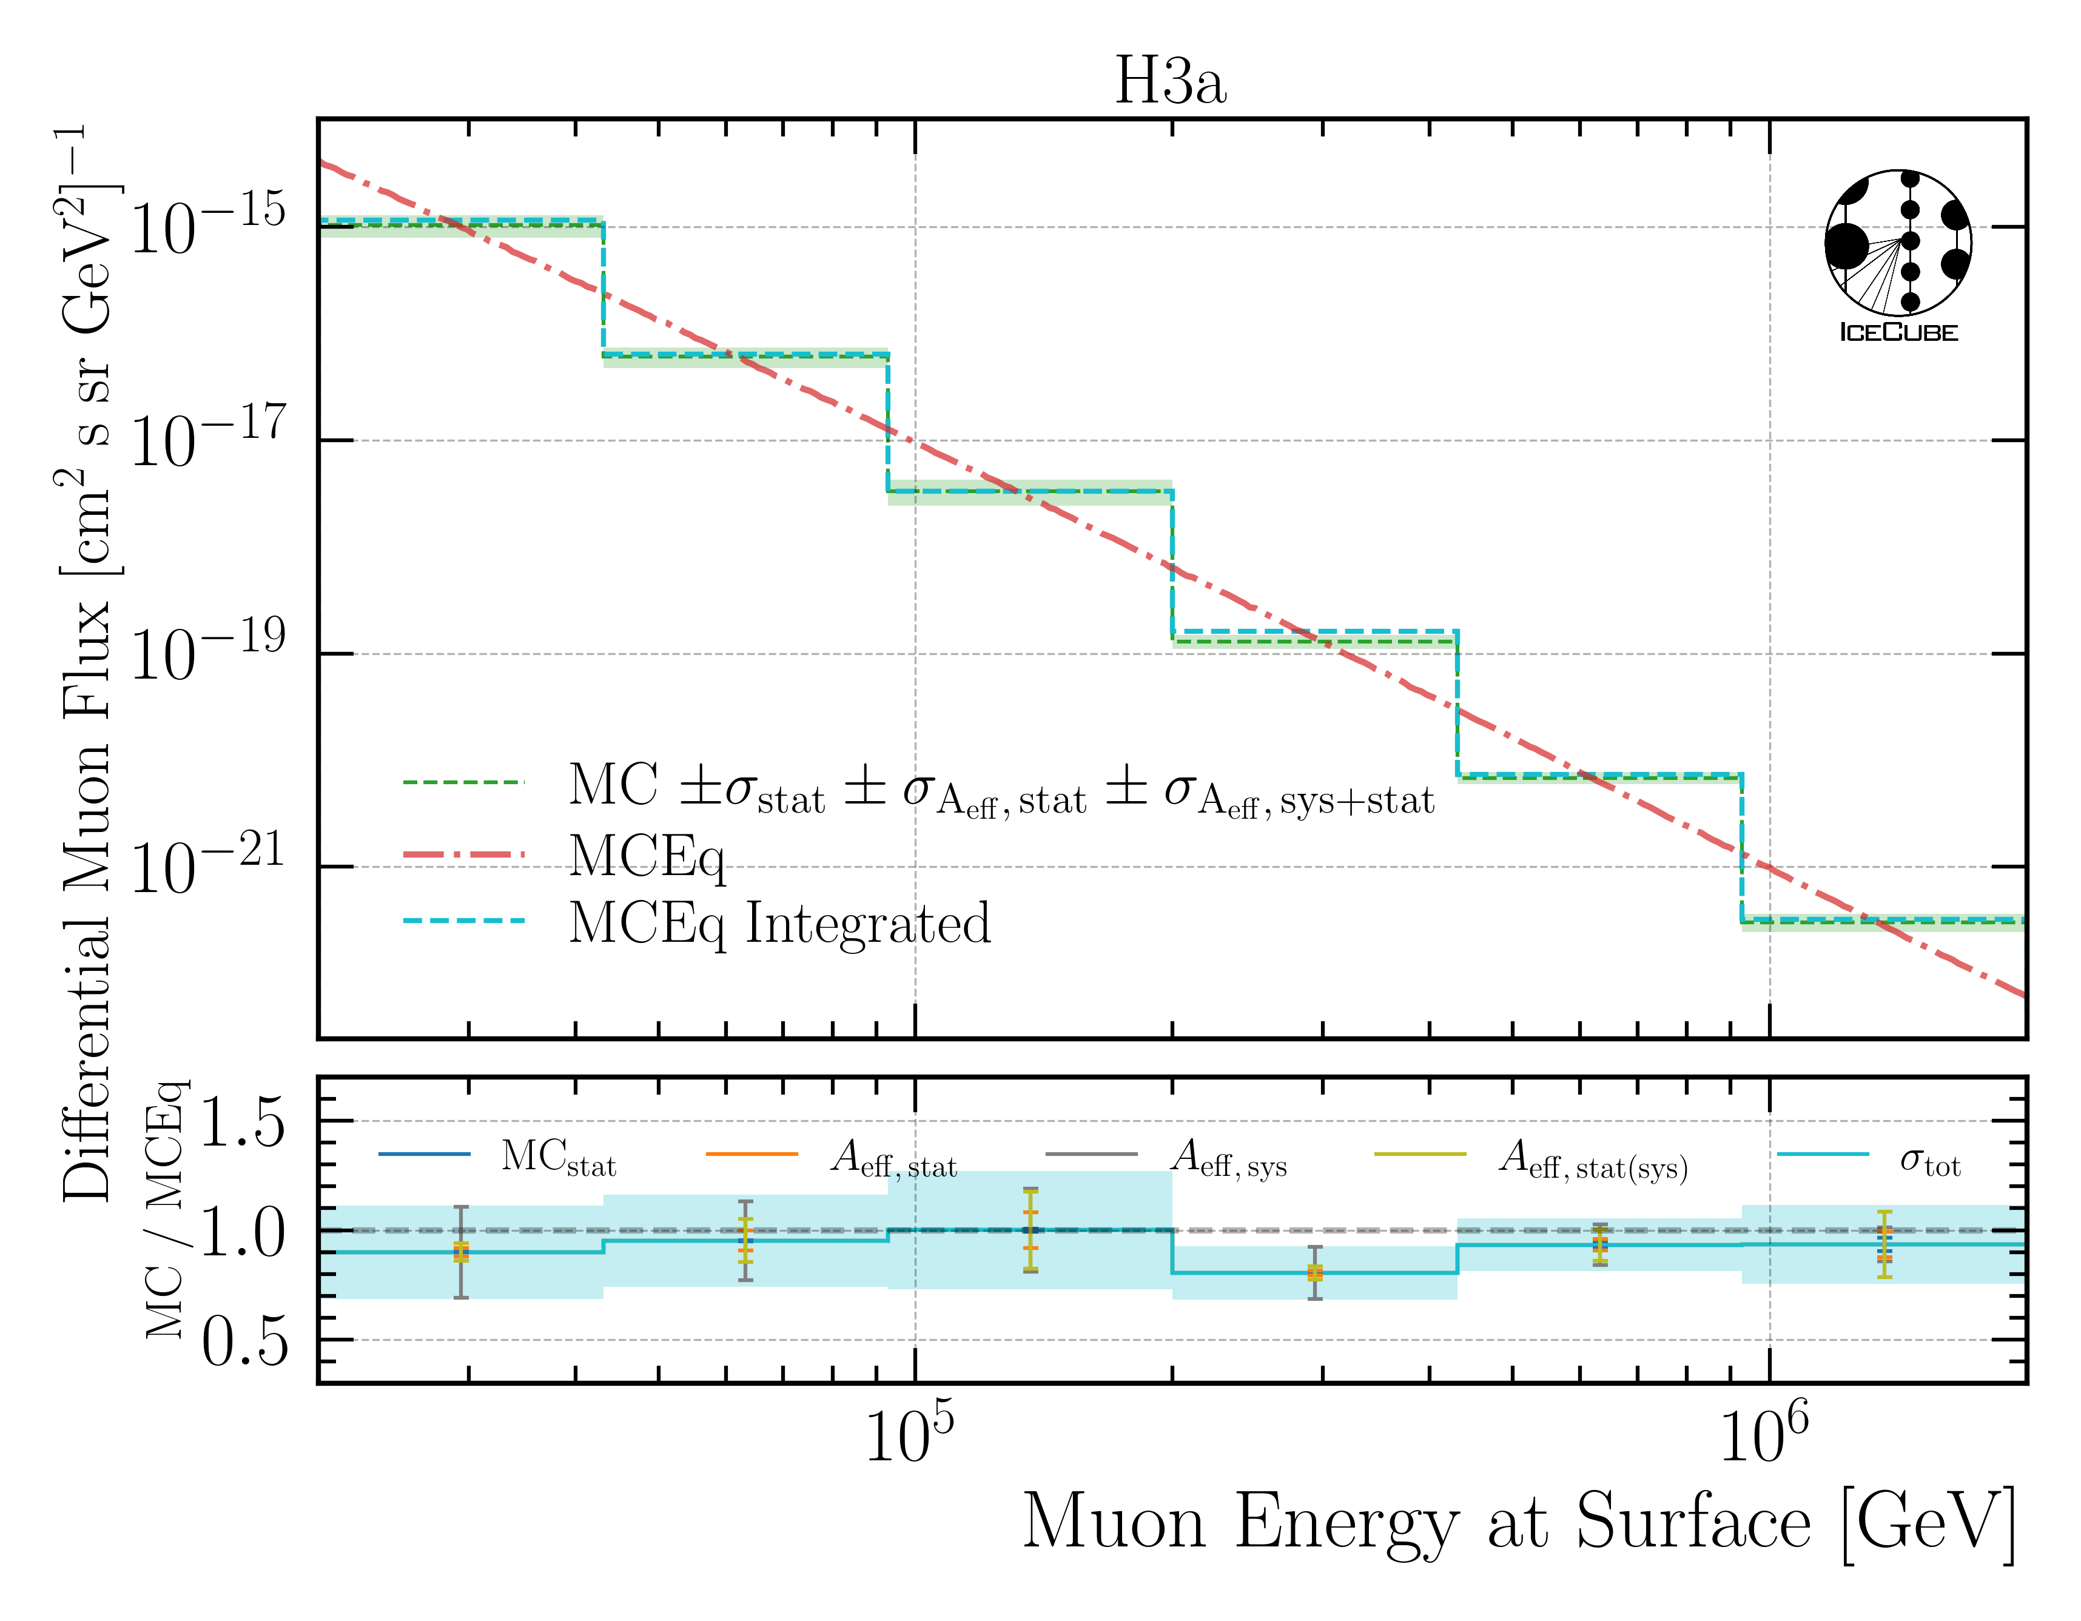
MCEq vs CORSIKA
Uncertainties on Flux
CORSIKA stat.
Eff. area stat.
Eff. area sys.
Eff. area stat. on sys. subset
Good agreement between MCEq & CORSIKA
𝛘²– Test (H3a):
p—value: 0.683

Slide 35
Unfold Burnsample

Slide 36
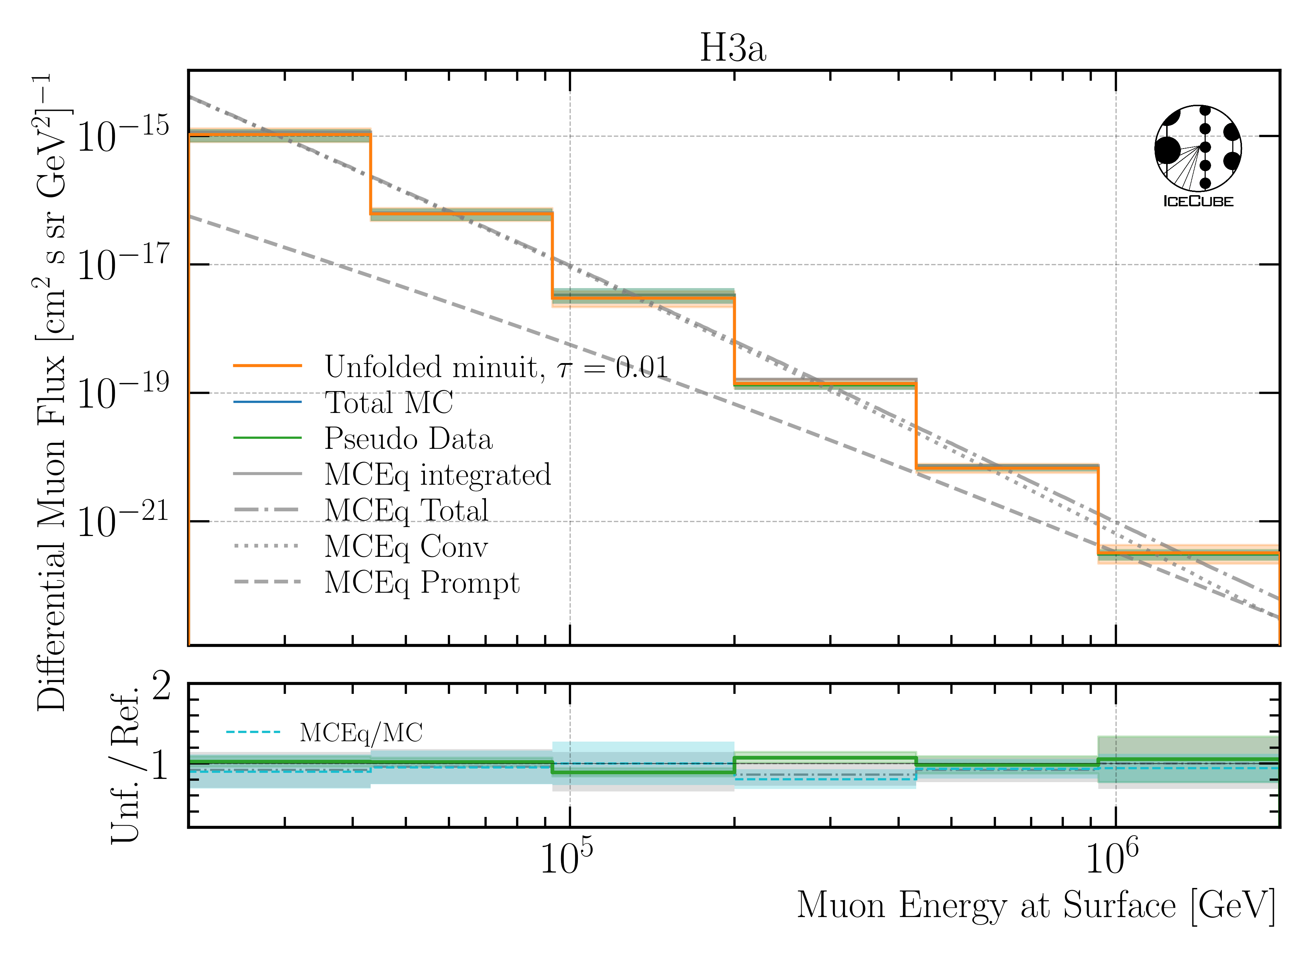
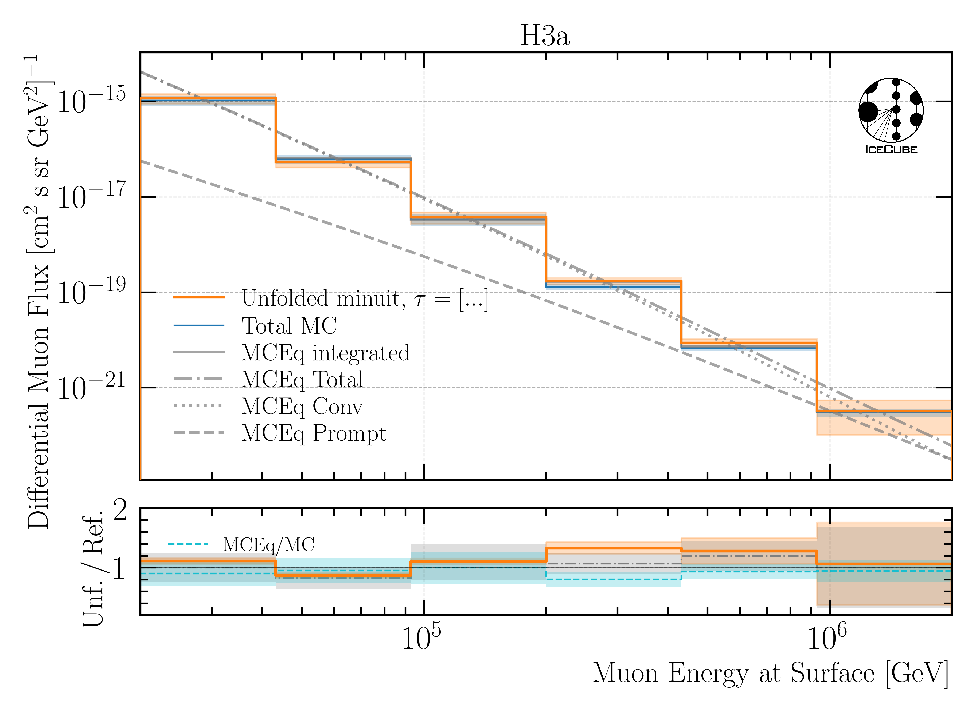
Unfold Burnsample
MC
Burnsample
𝛘²– Test (H3a) Conv only:
p—value: 0.587
Unfolding works on MC & burnsample

Slide 37
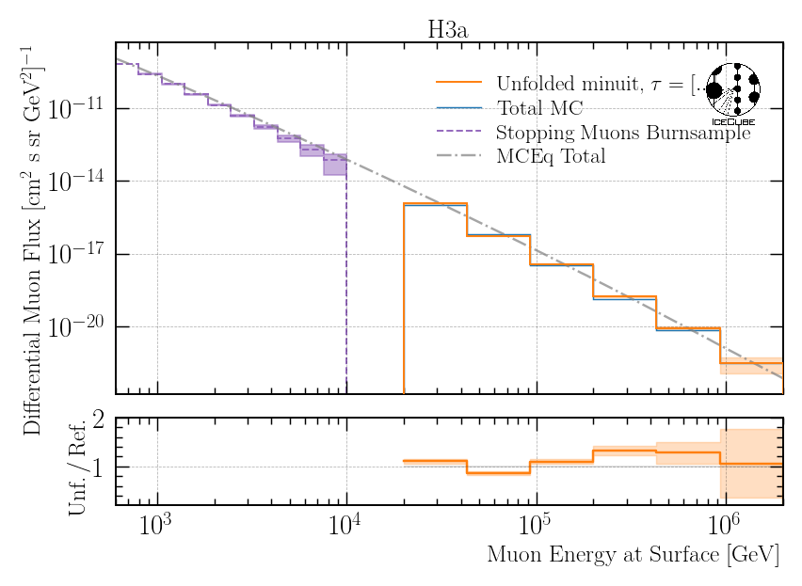
Stopping Muons and Leading Muons
Work in progress
Use stopping muons to unfold low energy muon spectrum
Use leading muons to unfold high energy muon spectrum
Atmospheric muon flux unfolding is promising

Slide 38
Conclusion & Outlook
Neutrino background investigated
BPL smaller impact than SPL
Include uncertainties on effective area
statistics & systematics
Agreement between MCEq & CORSIKA
Unfolded burnsample up to 2 PeV
Re-trained DNNs on new ice models
z—vertex Data-MC improved
Outlook
Unfold for different neutrino background assumptions
Evaluate new reconstructions in detail
Unfold on selection with new networks
Unfold on 12.12 years of data
Burnsample
Thank you for your attention!

Slide 39
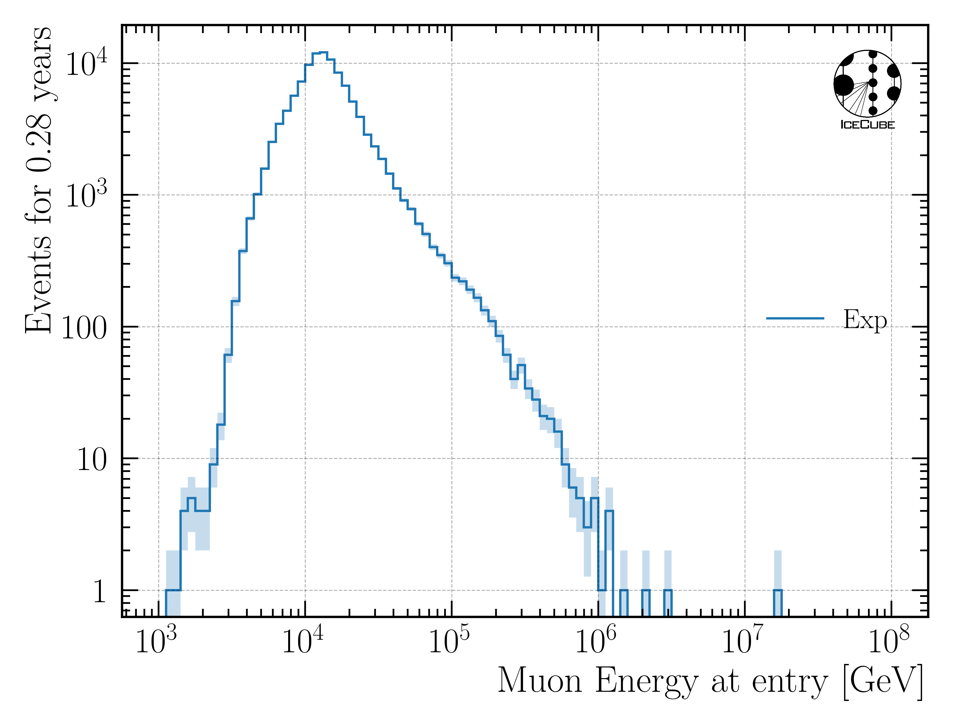
Burnsample Proxy

Slide 40
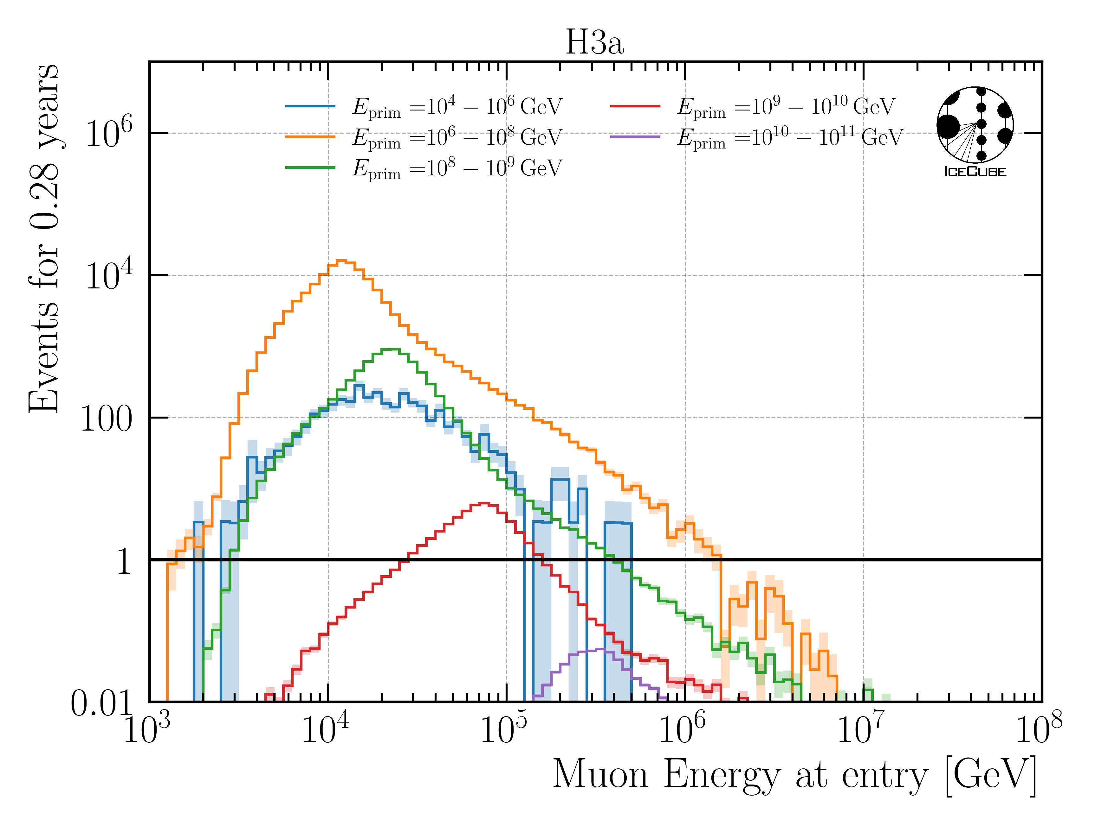
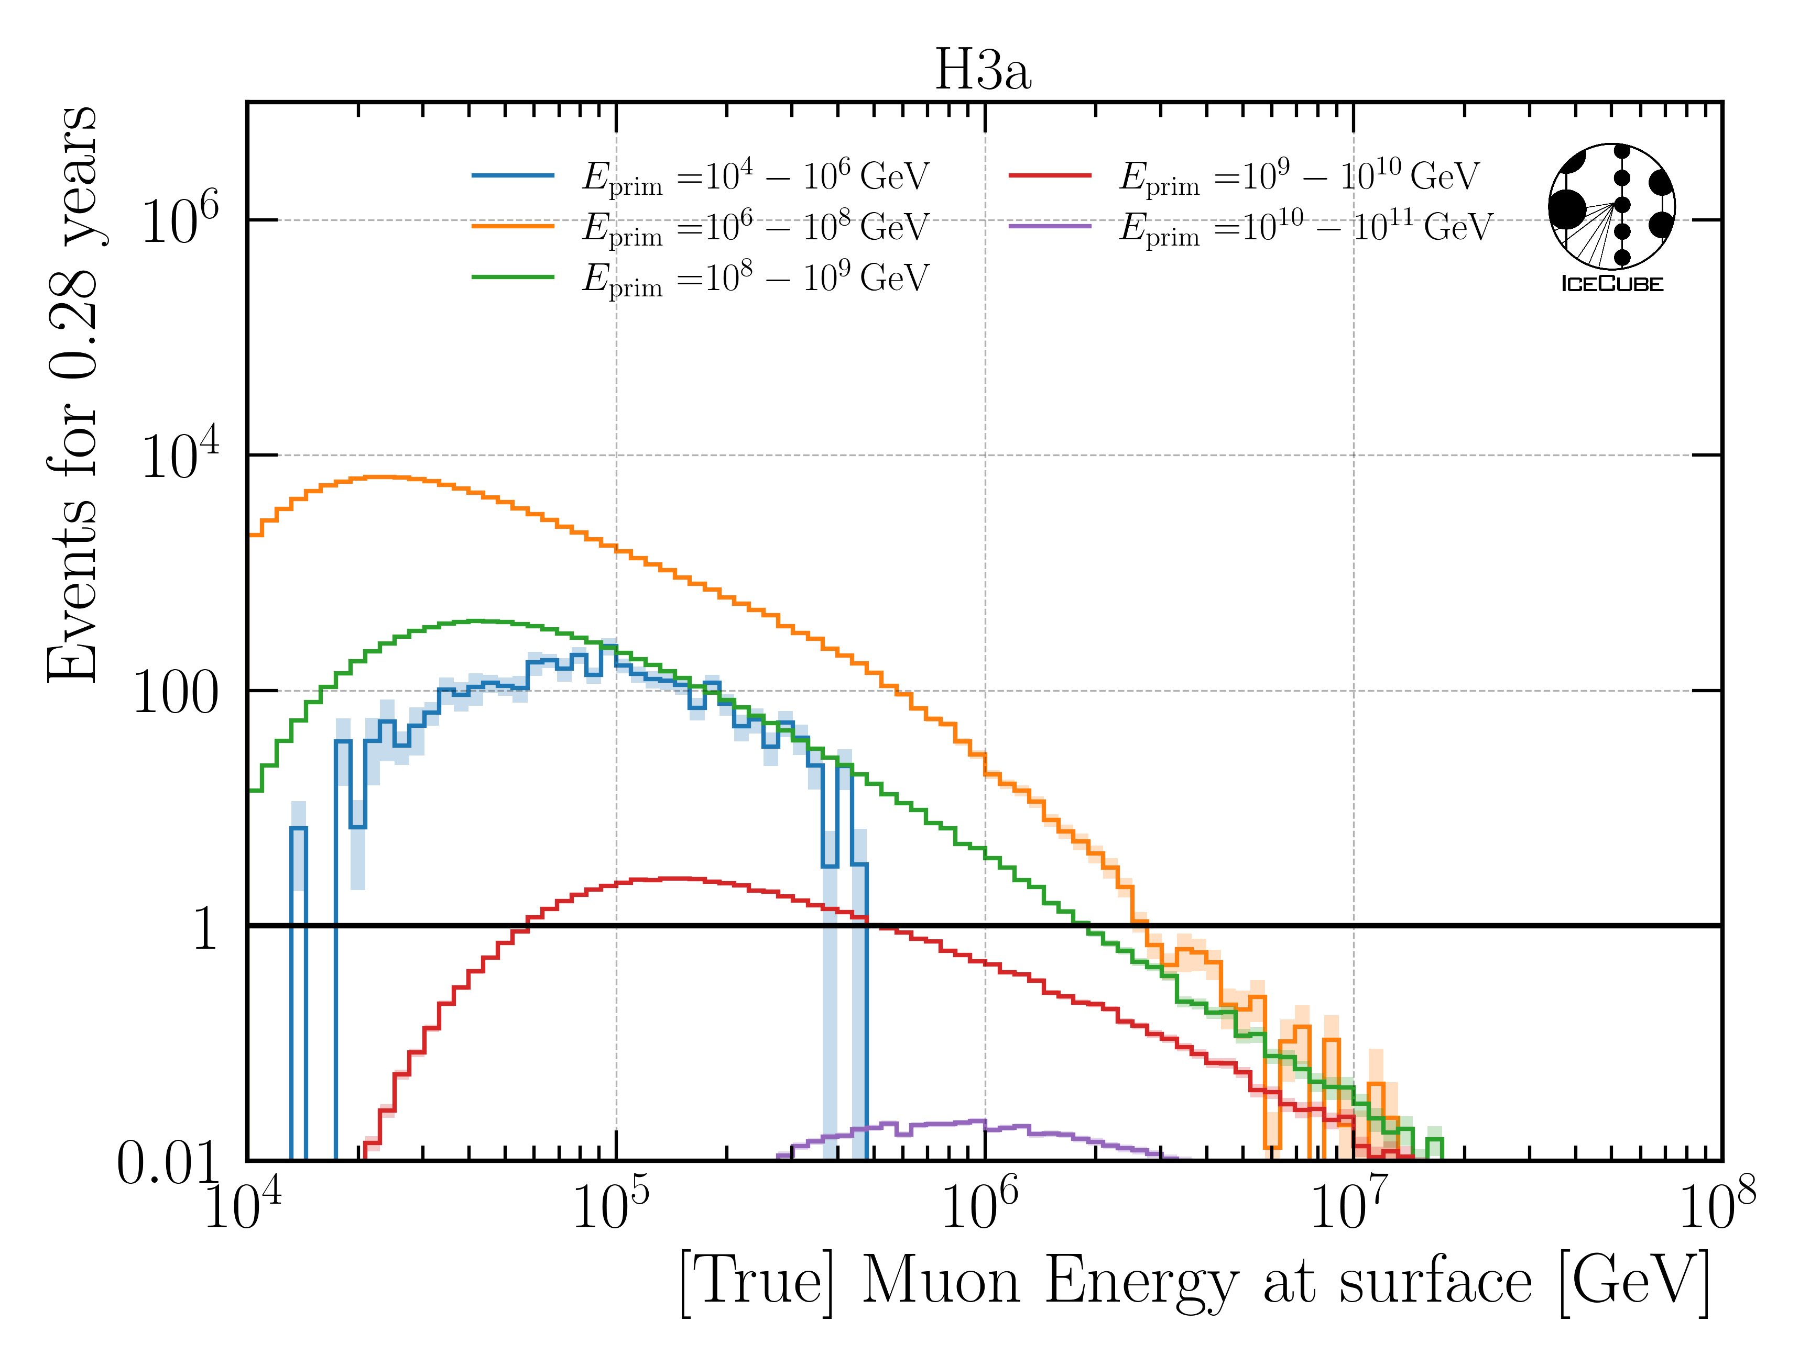
Statistics
Proxy
Target

Slide 41
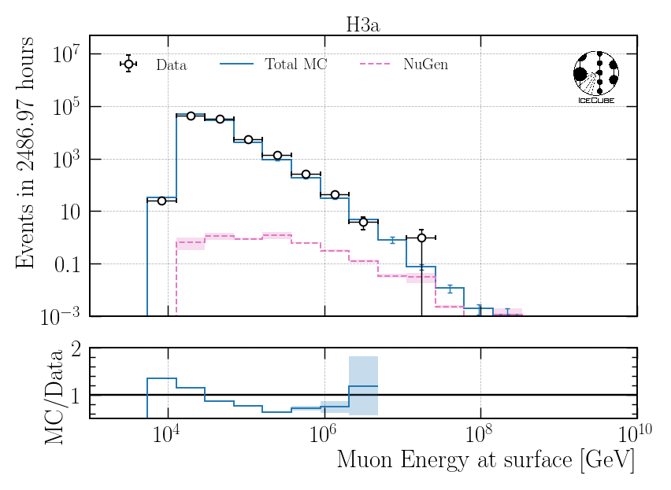
Remove Horizontal Events – Muon Energy at Surface
$$n=1.5, γ=2.6$$
NuGen: atmospheric and astro
NuGen: atmospheric and astro
$$\cos\left(Θ\right)>0.2$$
$$\cos\left(Θ\right)>0.4$$
Stronger zenith cut has no significant impact

Slide 42
Unblinding Roadmap
Unblind unfolding of the atmospheric muon flux for ICRC → unblinding request deadline May 1st
CRWG review → today
Technical review → next 2 weeks
Collaboration review → until May 1st
ICRC proceedings with unfolded muon flux
Run forward fit as post-unblinding check → unblind in summer
About 1-2 months needed
Method is fundamentally different from unfolding → blindness not violated
Journal paper proposal: includes both the unfolded muon flux and the normalization fit
finish first draft in Autumn
PhD deadline: July
Leander Flottau is working on forward fit
I’ll stay in academia → finish analysis

Slide 43
CRWG Review
Main questions are addressed here,
the rest is explained in the Q&A

Slide 44
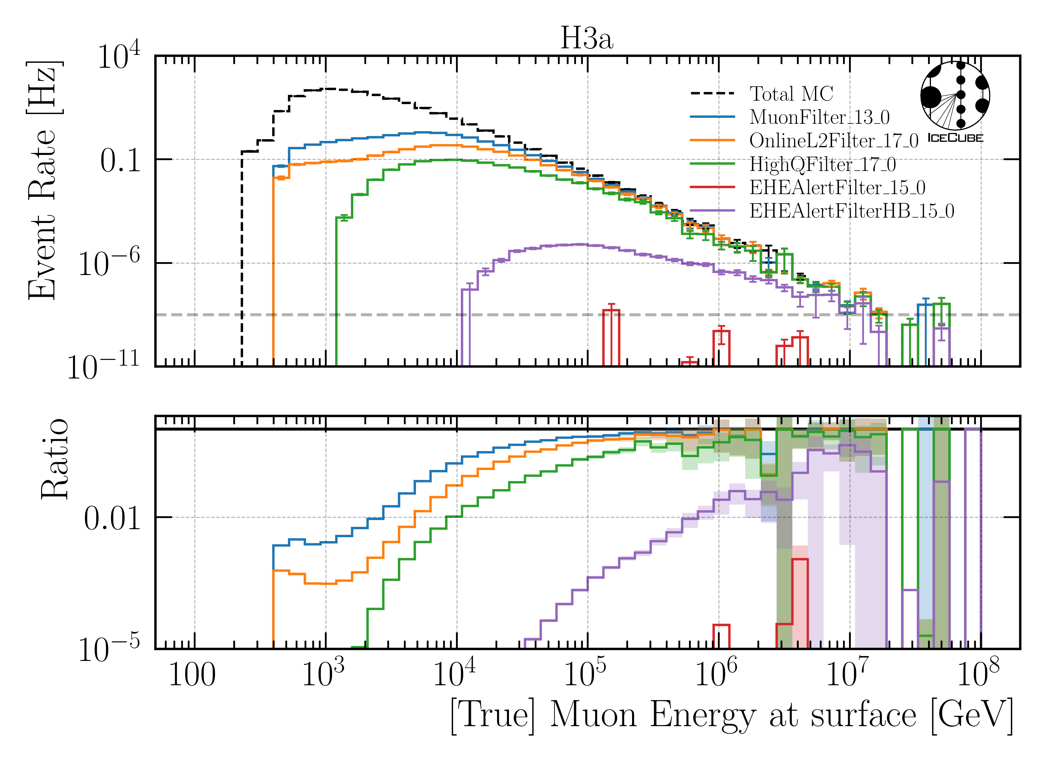
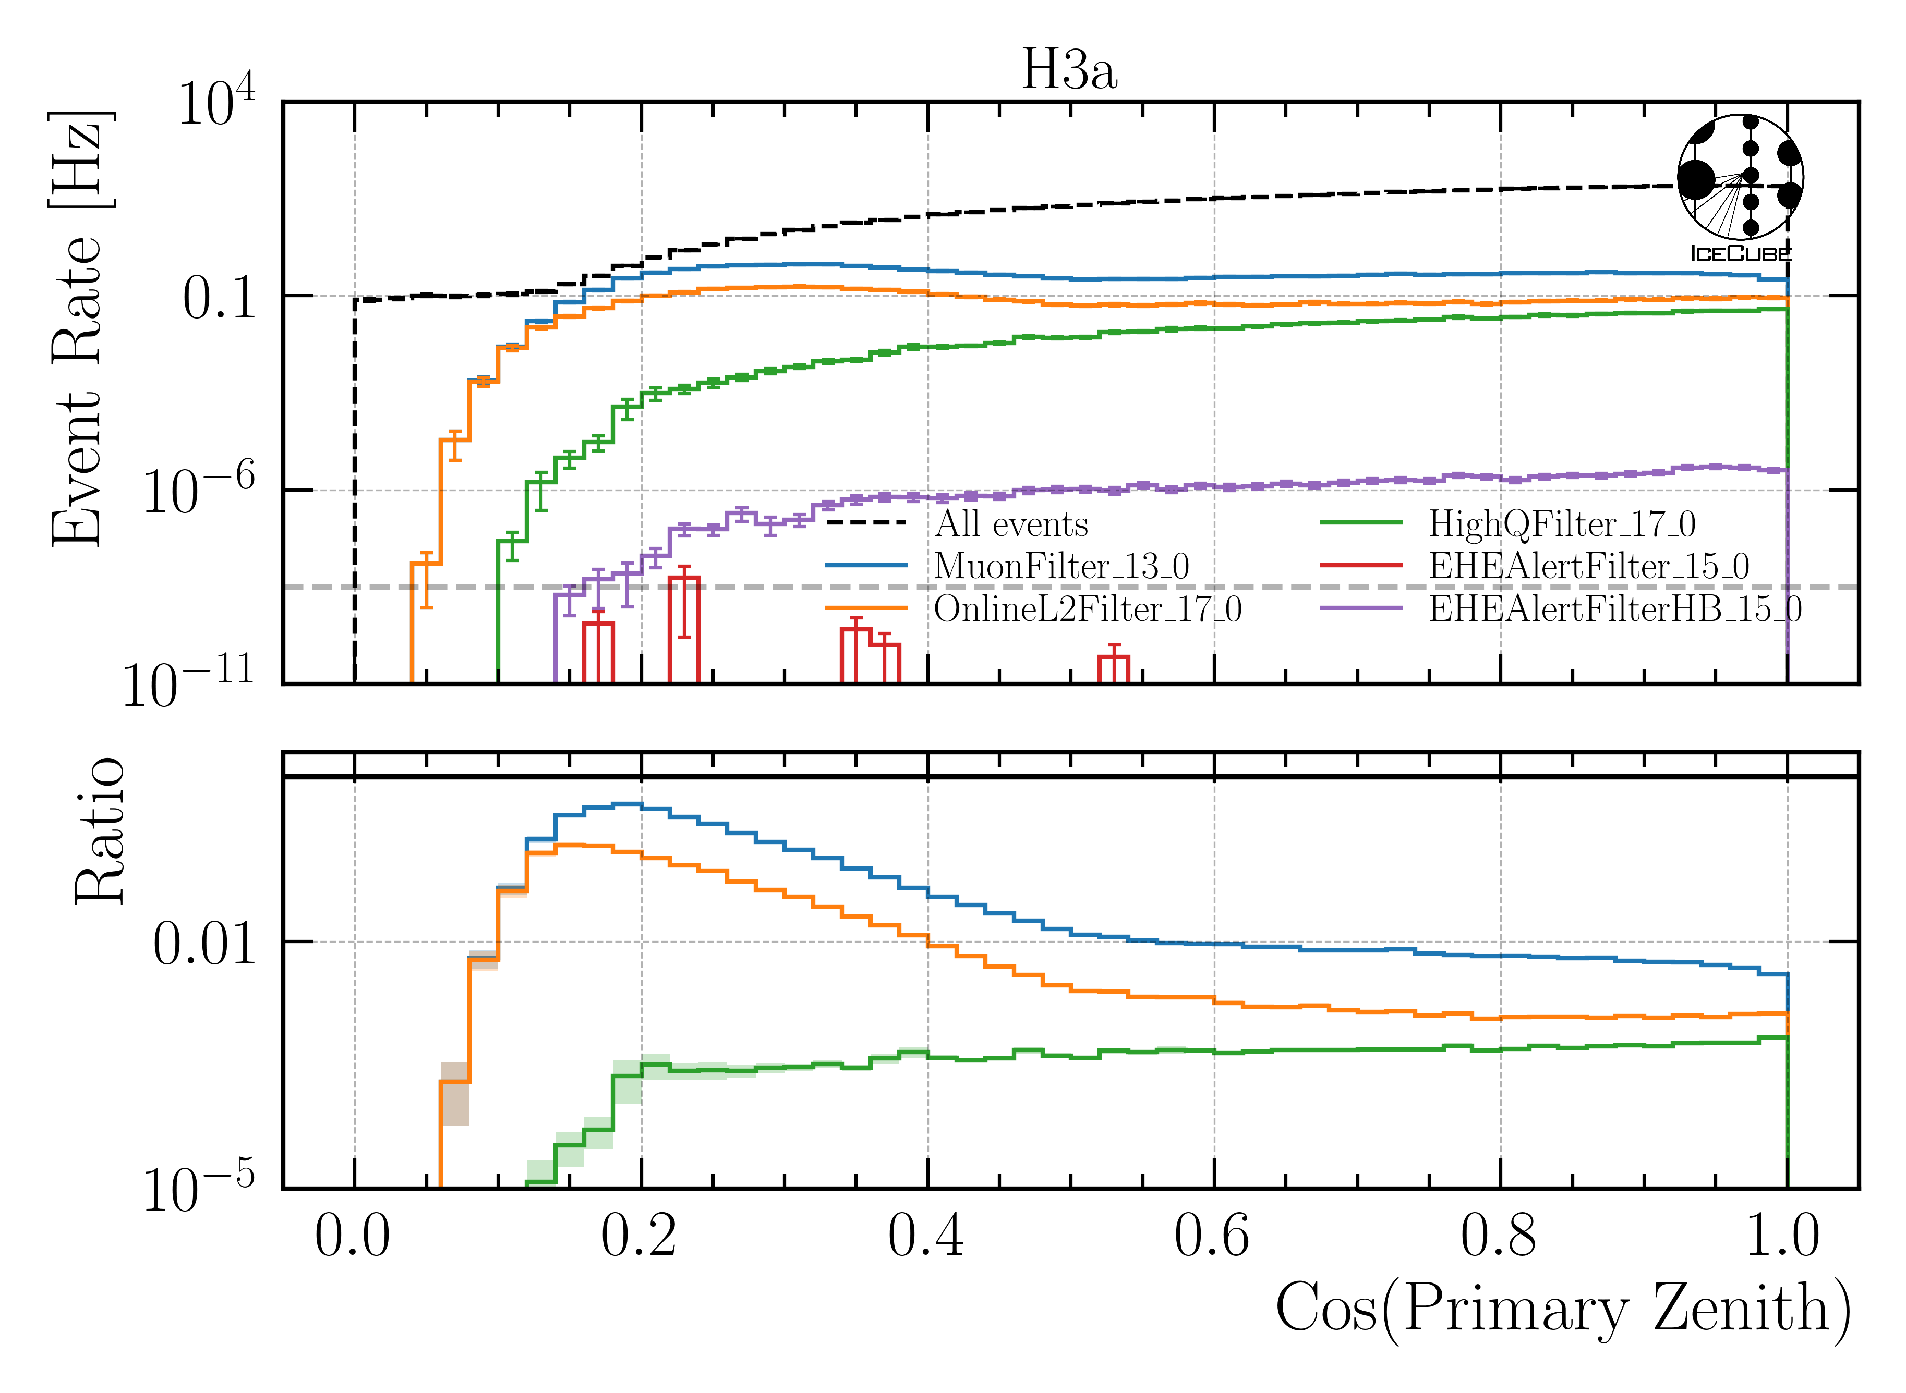
Q: Why do you choose the muon filter?
HighQFilter: removes more horizontal events → muons travel large distances, not enough energy left to pass high-charge filter
Goal: keep AMAP high-energy events at surface → muon filter

Slide 45
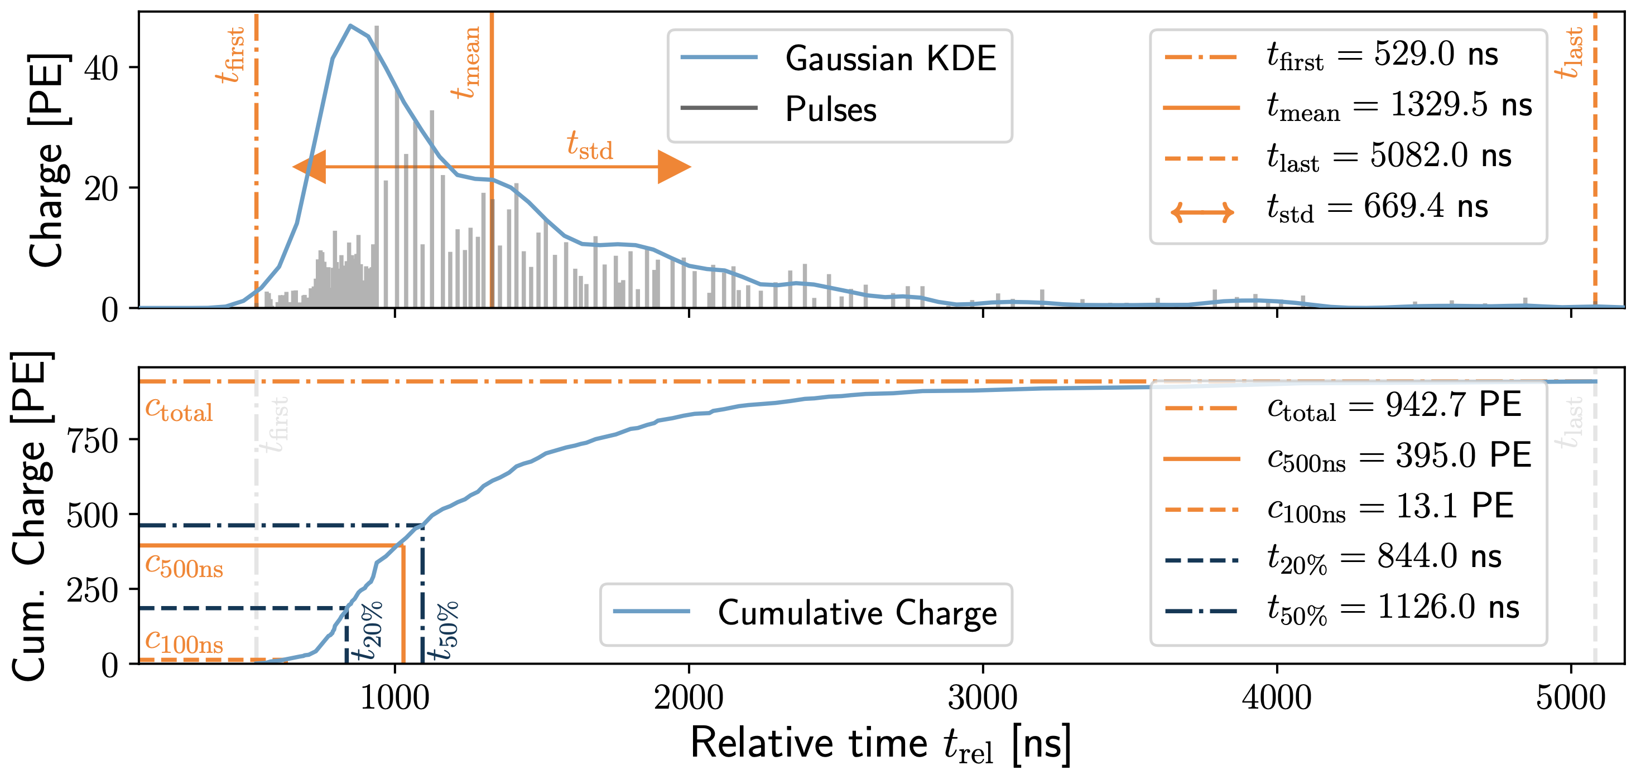
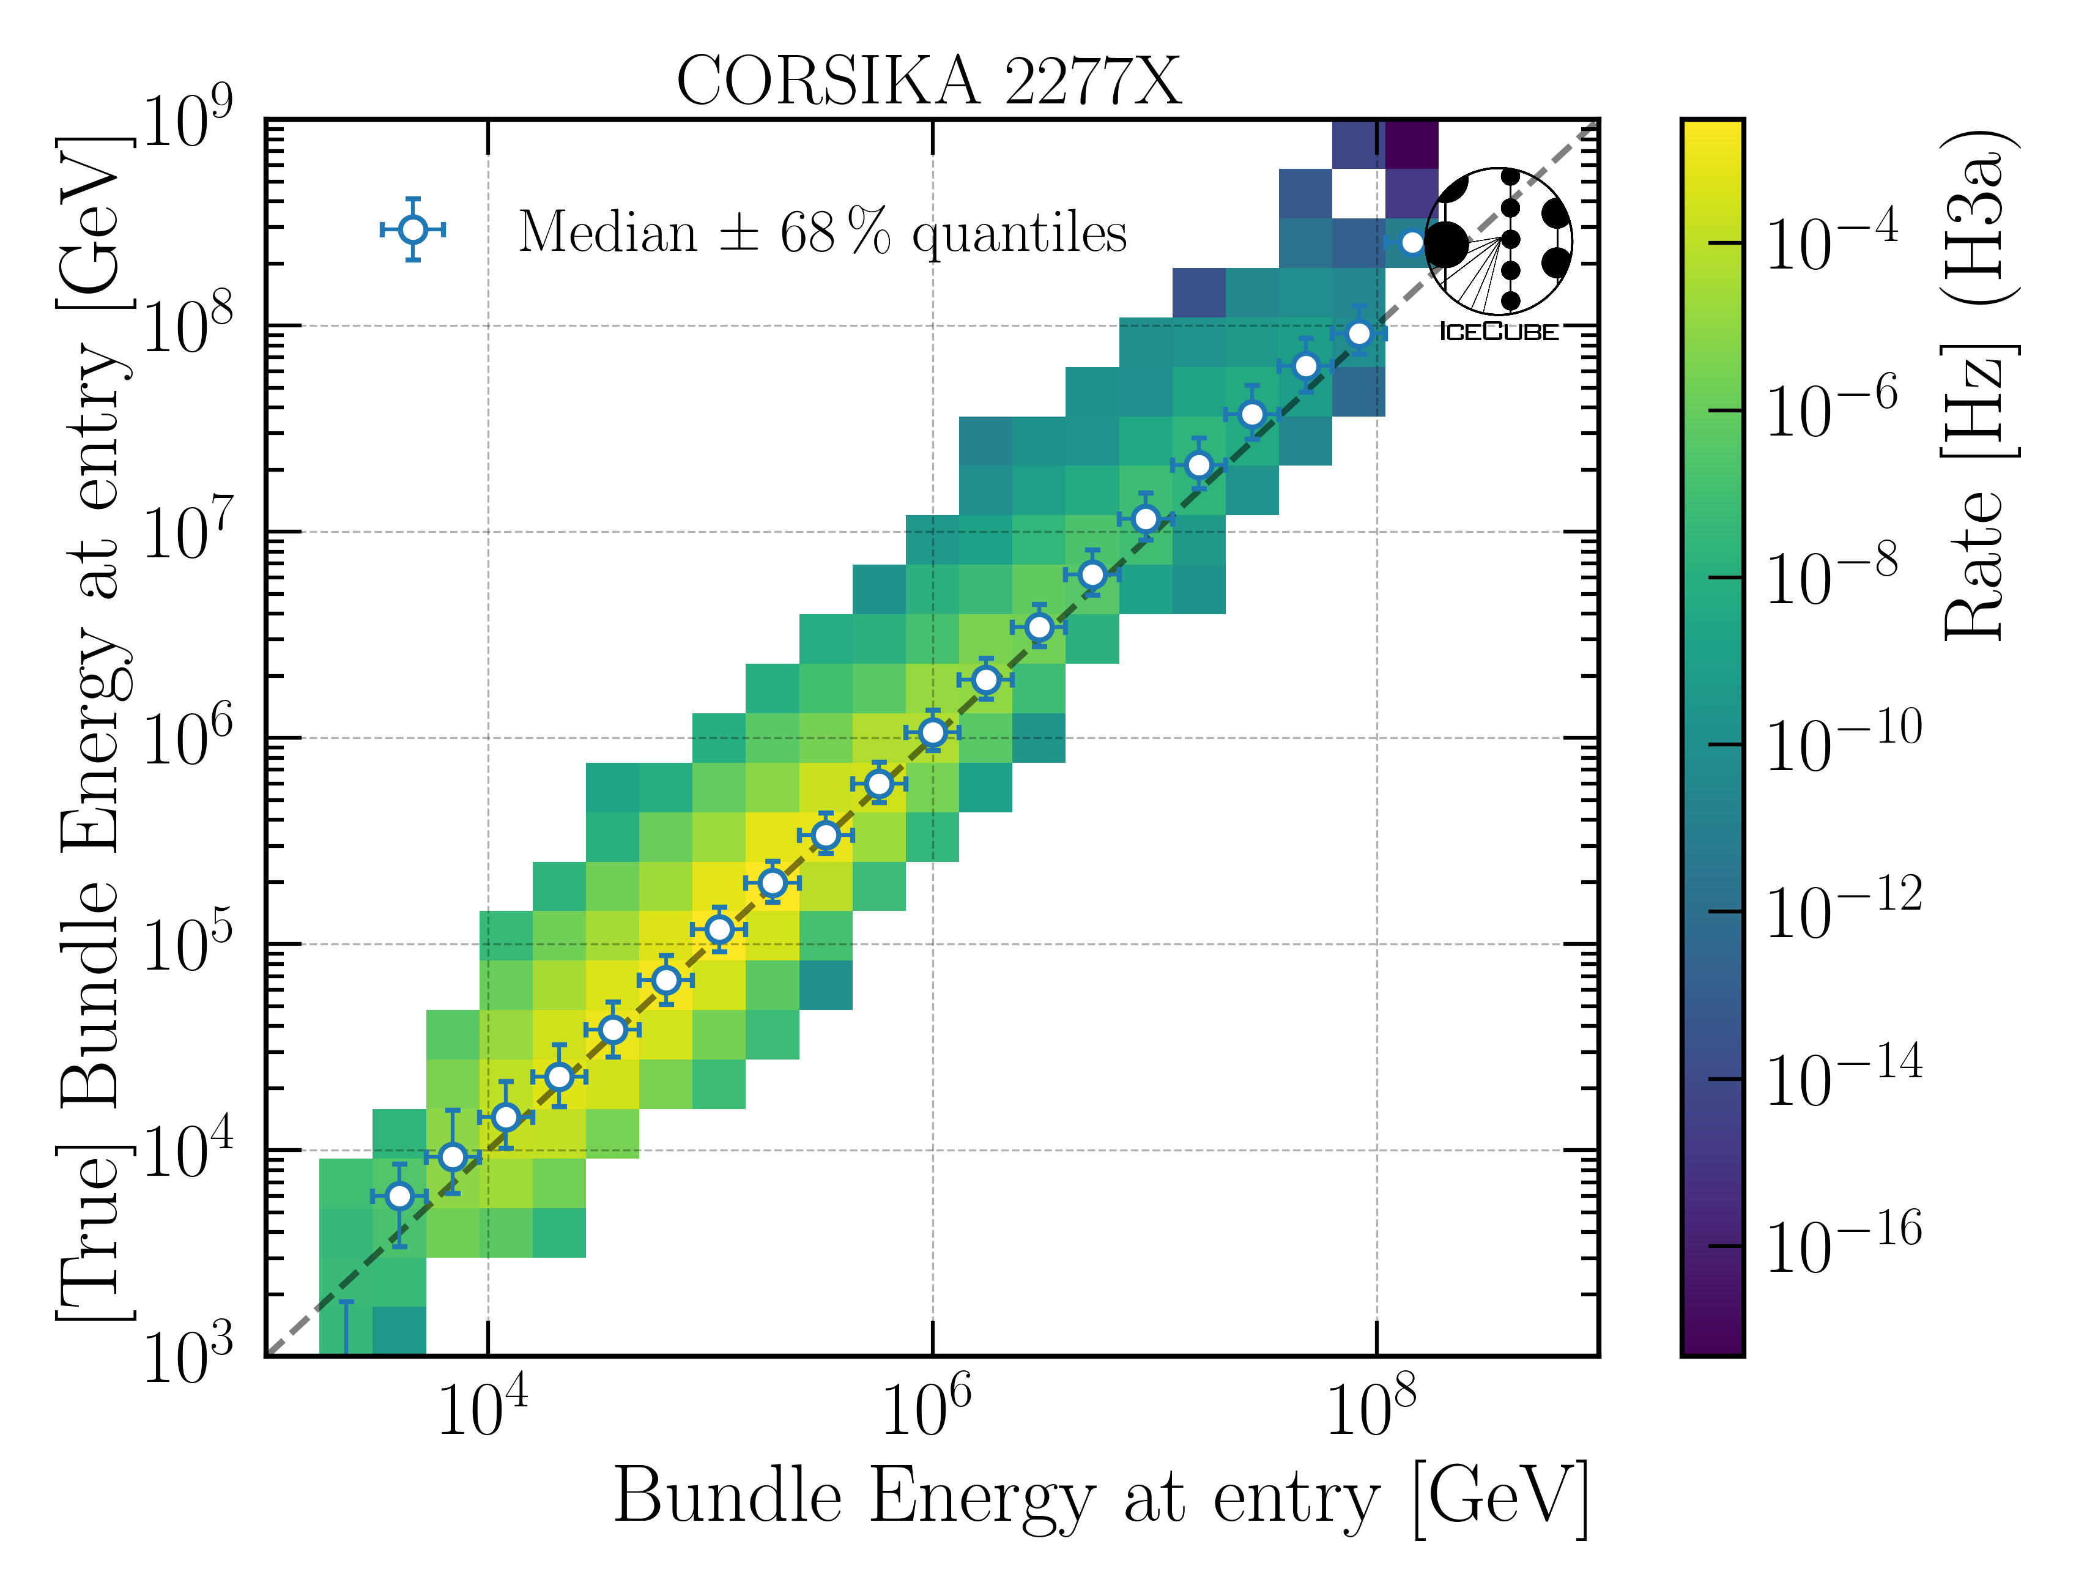
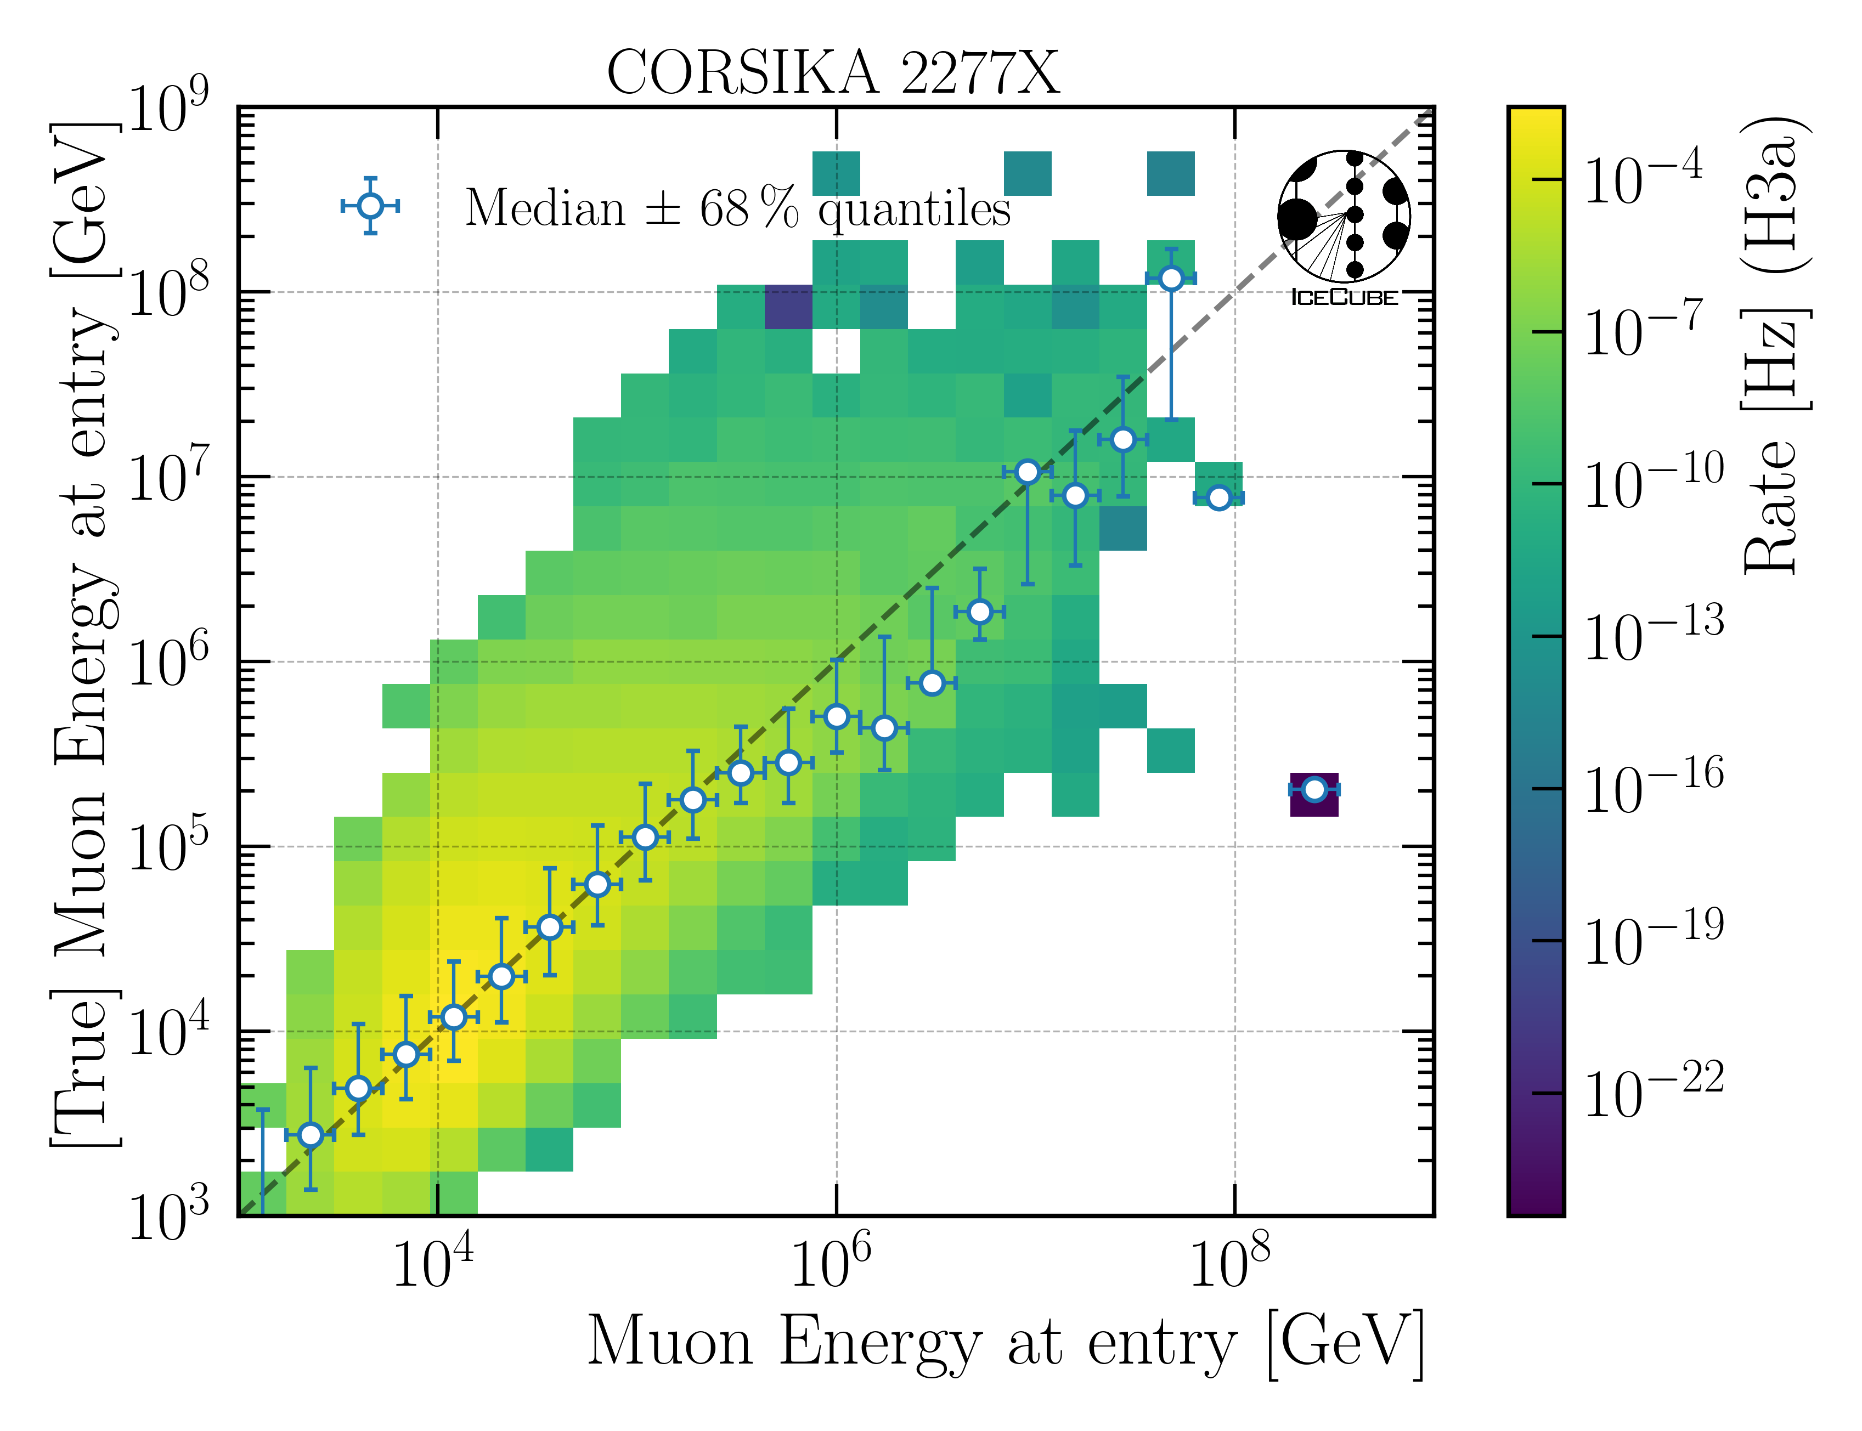
Q: Which quantities do you reconstruct and how do you do this?
10.1088/1748-0221/16/07/P07041
Energy
Bundle energy at entry / surface
Leading muon energy at entry / surface
Direction
Zenith / azimuth of leading muon
Geometry
Propagation length
Entry point
dnn_reco framework (Mirco Hünnefeld)
Low-level features based on charge and timer per DOM

Slide 46

Q: Coincident events are not simulated. Can you show that this does not cause any problems?
For primary energies above 10 TeV, using a time window of 6 µs, the chance for a coincident event is ≤ 1 %
Apply time-window cleaning of 6 µs to pulses
Linear scale
Log scale

Slide 47


Q: What is the impact of the primary flux on your (most important) distributions?
Primary models diverge towards higher energies

Slide 48

Q: Can you show a zenith distribution with prompt and conv?
conv
Conv dominates entire distribution by 1-2 orders of magnitude
Charm has no impact

Slide 49



Q: How do you treat systematics? → here for unfolding
Explained in the wiki here
Ice systematics – Snowstorm
Vary ice properties
Relative change of bin content
Fit as nuisance parameter
Cosmic ray primary flux models
Build matrix for different primary models and show that the result is independent of the input model
Hadronic interaction models
CORSIKA simulations are extensive, we rely on SIBYLL 2.3d (similar to the primary flux, the impact should be negligible)
impact on proxy
parameterization

Slide 50
Conclusion & Outlook
Move forward with unblinding the unfolding for ICRC
May 1st
Run normalization fit as post-unblinding check
Answered CRWG questions
Finish technical review
Ask for a collaboration reviewer
✅
Thank you for listening. Do you have more questions?

Slide 51
Unfolding

Slide 52









Unfolding in a nutshell
folding
unfolding
1. discretized form: $\vec{g}=A\vec{f}↔\vec{f}=A^{−1}\vec{g}$
measured proxy
detector response
background
$$g\left(y\right)= \int_{E0}^{E1}{A\left(Eµ , y\right)f\left(Eµ\right) dEµ+b\left(y\right) }$$
2. maximum likelihod method:
$$ℒ\left(\vec{g} | \vec{f}\right)=\prod_{j=1}^{M}{\frac{λ_{j}^{g_{j}}}{g_{j}!}exp⁡(−λ_{j})}$$
3. Thikonov regularization:
$$t\left(\vec{f}\right)=−\frac{1}{2}{\left(C\vec{f}\right)}^{T}{\left(τ1\right)}^{−1}(C\vec{f})$$
true energy distribution
$$=\prod_{j=1}^{M}{\frac{{(A\vec{f})}_{j}^{g_{j}}}{g_{j}!}exp⁡(−{(A\vec{f})}_{j})}$$
funfolding
by M. Börner
4. maximize $log⁡(ℒ\left(\vec{g} | \vec{f}\right))+t\left(\vec{f}\right)$
with respect to $\vec{f}$ using
Markov Chain Monte Carlo (MCMC)
or Minuit
Credit: T. Hoinka

Slide 53

Proxy vs Target

Slide 54
Unfold Event Rate

Slide 55

Event Rate

Slide 56
Unfold Muon Flux

Slide 57


Muon Flux at Surface

Slide 58



Check impact of primary input model
build model on H4a
unfold H3a, H4a and GSF
green line should align with 1
Unfolding independent of input primary flux model
grey ratio to MCEq depends on the expectation value per bin, here this is calculated based on H4a
→ this leads to minor deviations for H3a and GSF

Slide 59
Ice Systematics
Snowstorm
Scattering
Absorption
DOMEfficiency
Hole Ice Forward p0
Hole Ice Forward p1

Slide 60




Systematics Impact on Muon Energy at Entry (Proxy)
HoleIce p0
Scattering
HoleIce p1
Divide systematic range into 5 equidistant bins
Largest impact by DOMEfficiency and Absorption
DOMEfficiency
Absorption

Slide 61





Systematics Impact on Muon Energy at Surface (Target)
HoleIce p0
Scattering
HoleIce p1
Divide systematic range into 5 equidistant bins
Largest impact by DOMEfficiency and Absorption
DOMEfficiency
Absorption

Slide 62





Chi2 Test: Muon Energy at Entry (Proxy)
HoleIce p0
Scattering
HoleIce p1
Chi2 test between lower and upper systematic range bin
No impact from Hole Ice p1
Small impact from Scattering and Hole Ice p0
DOMEfficiency
Absorption

Slide 63
Parameterize Systematics
Vary each systematic parameter for each proxy bin (18 proxy bins, 3 systematic bins)
Fit the relative change of the bin content
Chi2 test, if constant y = 1 is compatible with data points (p-value = 0.05)
Find linear fit with the lowest slope that is compatible with p-value = 0.2
Require fit is going through (center, 1)

Slide 64
Absorption

Slide 65
DOMEfficiency

Slide 66
Hole Ice p0 → not sensitive enough (same for Hole Ice p1)

Slide 67
Scattering

Slide 68
Unfold Muon Flux with Systematics
No regularization

Slide 69
Muon Flux at Surface (no regularization)

Slide 70
Unfold Muon Flux with Systematics
With regularization

Slide 71
Muon Flux at Surface (Tau = 0.001)

Slide 72
Systematic bins
Tau = None
Tau = 0.001
underflow bin
Regularization minimizes the correlation
Find tau with the minimum correlation
overflow bin

Slide 73
Conclusion
Unfold muon event rate ✅
Unfold muon flux at surface ✅
Parameterize ice systematics ✅
Small impact from Scattering, Hole Ice p0 , and Hole Ice p1
Linear parameterization of Absorption and DOMEfficiency
Unfold muon flux with systematics ✅
Next steps
Test impact of different primary models (spectral index)
Choose optimal regularization

Slide 74
Backup

Slide 75


Relation between primary energy and muon energy at surface and entry

Slide 76


Proxy vs. target
1 year
10 years

Slide 77


Unfolding event rate
1 year
10 years

Slide 78


unfolding of muon flux at surface
1 year
10 years

Slide 79
Ice systematics
Snowstorm
Absorption
Scattering
DOMEfficiency
HoleIce 0
HoleIce 1

Slide 80





Fit ice systematics:
Parametrization for systematics in each proxy bin
Proxy: leading muon energy at entry
This is done for each systematic and every proxy bin

Slide 81



Unfolded event rate with systematics
work in progress
Use regularization to reduce unphyiscal oscillations

Slide 82

Conclusion & outlook
New CORSIKA simulations with parent information
tag prompt and conventional muons
validation: agreement with MCEq
Add DNN-based reconstructions
Good data-MC agreement
quality cuts defined
good agreement in cos(zenith) distributions
mismatch in z—position → re-weight distributions
Unfolding is set up
systematics can be included, minor investigations
Fit of prompt normalization is promising
systematics need to be included
How ChatGPT illustrates the detection of a prompt muon with IceCube.
Thank you for your attention!

Slide 83
Selection

Slide 84


level3: muon filter
HighQFilter: removes more horizontal events → muons travel large distances, not enough energy left to pass high-charge filter
Goal: keep AMAP high-energy events at surface → muon filter
Notes:
muon filter checks for number of hit channels and charge for 3 different zones onlineL2filter also checks for hit channels, charge and 3 zones, but also a couple of more properties like multiplicity, direct hits and specific shapes in the Qtot distribution (kinks, slope)

Slide 85


level3: 500 TeV bundle cut at surface
6 billion events expected: computationally not feasible → focus on high-energetic events
500 TeV cut: 6.7 Mio events left
use fast pre-cut network to estimate bundle energy at surface

Slide 86
Data-MC

Slide 87


Cos(zenith)

Slide 88


Entry position z—vertex

Slide 89

z—reweighting
re-weight events to enforce a perfect agreement in the center z—position

Slide 90


Check z—reweighting
re-weighting has no large effect on cos(zenith) and energy

Slide 91
Level5: quality cuts
containment cuts | > | <
length in detector | 1000 m | 2000 m
entry pos x, y | -750 m | 750 m
entry pos z | -500 m | 750 m
center pos x, y | -550 m | 550 m
center pos z | -650 m | 650 m
uncertainty cuts | <
bundle energy at entry | 0.9 log10(GeV)
bundle energy at surface | 2.0 log10(GeV)
zenith | 0.1 rad
azimuth | 0.2 rad
entry pos x , y, z | 42 m
center pos x, y, z | 50 m
entry pos time | 200 ns
center pos time | 600 ns
length in detector | 160 m
length | 2000 m
neutrino cuts | > | <
cos(zenith) | 0.2
length | 5000 m | 15000 m

Slide 92


Level5: quality cuts → removes neutrinos
network learns: a high-energetic horizontal event in the detector needs a very high energy at surface

Slide 93
Rates per month
Data-MC

Slide 94


Rates per month – Level 5
scaled on Level 4

Slide 95


Rates per month
before quality cuts
after quality cuts
total offset in rate per month

Slide 96

Rates per month: scaled
Rates are scaled to the experimental rate to compare the shapes
Good agreement per month

Slide 97


unfolding of muon flux at surface – weighted to E^{3.7}
1 year
10 years

Slide 98


Muon flux
Most energetic muon in bundle
Muon parent:
pion or kaon
yes
no
$φ_{tot}=φ_{prompt}+$ $φ_{conventional}$
conventional
prompt
Credit: Ludwig Neste
Notes:
gamma = 2.7: SNR → fermi/shock acceleration, propagation of cosmic rays lead to interactions with galactic magnetic fields, interactions with gas, energy losses (ionization and nuclear interactions), in this process, some cosmic rays can escape the magnetic fields → this rate is energy dependent → higher-energtic cosmic rays escape more quickly → steepening of spectrum to ~2.7

Slide 99

Prompt atmospheric muons and neutrinos
10.1103/PhysRevD.100.103018
no unflavored
dominated by pions
dominated by kaons
Combined fit:
handle on pion/kaon ratio
handle on charmed mesons

Slide 100

Leading muon energy fraction
Solid: conventional
Dashed: prompt
Prompt dominates for energies > 1 PeV
Leading energy sweet spot: 0.1 – 0.9

Slide 101


Leading muon contribution
Patrick Berghaus
Muons with energies between 100 TeV and 50 PeV dominate the bundle by more than 90%
In average conventional muons are more dominant than prompt
But: at high energies, there are more prompt than conventional events
High leading energy fraction does not lead to more sensitivity to detect prompt

Slide 102




Muon puzzle and hadronic uncertainties
”muon number”
Expected z
(“muon number”)
2012
2108.08341
1208.1520
Uncertainties at E > 10 PeV
2020
More muons measured than simulated for E > 40 PeV ~ cms 8 TeV
2006.05012

Slide 103

The Muon Puzzle
”muon number”
2108.08341

Slide 104

Possible Solutions
Hans Dembinski

Slide 105
Simulation w/o coincident events
for primary energies above 10 TeV, using a time window of 6 µs, the chance for a coincident event is ≤ 1 %

Slide 106
Bundle energy cut
Rate after muon filter: 24.62 Hz
If the process of 1 event needs 1 second, 8h run takes 200h -> needs to be reduced!
Use small, fast network to remove low energy events -> target rate 125 mHz
CPU runtime: 11 ± 1ms
GPU
Network: precut_surface_bundle_energy_3inputs_6ms_01

Slide 107
Leading muon energy fraction - leadingness
True muon energy fraction is smeared
Network tries to predict the median of the distribution

Slide 108
Bundle energy at entry – 6 µs cleaned pulses
Median + 90% quantile
Prediction
True

Slide 109
Leading muon energy at entry – 6 µs cleaned pulses
Median + 90% quantile
Prediction
True

Slide 110
Bundle energy at surface – 6 µs cleaned pulses
Median + 90% quantile
Prediction
True

Slide 111
Leading muon energy at surface – 6 µs cleaned pulses
Median + 90% quantile
Prediction
True

Slide 112
Zenith – 6 ms cleaned pulses
Median + 90% quantile
Prediction
True

Slide 113
Azimuth – 6 ms cleaned pulses
Median + 90% quantile
Prediction
True

Slide 114
SplineMPE – DNN and conventional seeds
SplitInIceDSTPulsesTWCleaning6000ns

Slide 115
SplineMPE – DNN seeds
SplitInIceDSTPulsesTWCleaning6000ns
DNN contours

Slide 116


Level5: cos(zenith)
Caution: weights are scaled

Slide 117

Level5: cos(zenith) – all primary models
Caution: weights are scaled

Slide 118


Proxy and target variable for unfolding – 10 years [H4a]

Slide 119

Unfolding with prompt and conv MCEq

Slide 120


Prompt and conv: muon energy at surface for 10 years

Slide 121


Compare all primary fluxes

Slide 122
Angular reconstructions: DNN vs. SplineMPE
DNN contours
DNN: ~6ms
Only small improvement at energies around 1 PeV
Countours are larger
Additional runtime
-> Use only DNN reconstruction, since we do not need the best angular resolution
Notes:
angular resolution: opening angle between true and reconstructed

Slide 123
Forward fit

Slide 124


Expected muons for 10 years: leading vs. bundle energy (GSF)
leading: energy of most energetic muon in a muon bundle
bundle: sum of energies of all muons of the bundle
L2 MuonFilter
L2 MuonFilter
Both leading and bundle energy are sensitive to detect prompt
Leading muon energy is more sensitive

Slide 125


Pseudo data sampling
Cuts:
L2 MuonFilter
Bundle energy at entry > 100 TeV
Tagging allows scaling of prompt by factor n_{pr}

Slide 126





Poisson likelihood fit performed in leading muon energy
Cuts:
L2 MuonFilter
Bundle energy at entry > 100 TeV
Test bias
Prompt scaling/normalization
MC counts per bin i
Conv norm = 1
Experimental counts
Maximize likelihood
With a constant conv norm:
bin counts depend only on prompt norm
= expectation value per bin
Easier:
minimize negative
log-likelihood
Test statistic for Wilks’ theorem
Bias starts at a prompt normalization of ~0.1
Null hypothesis: no prompt

Slide 127

Discovery potential and sensitivity
Cuts:
L2 MuonFilter
Bundle energy at entry > 100 TeV
Expectation for 1 year:
5 sigma discovery potential: 0.102 ± 0.005
Sensitivity: 0.024 ± 0.001
Expectation for 10 years:
5 sigma discovery potential: 0.032 ± 0.001
Sensitivity: 0.007 ± 0.000
Caution:
Limited MC statistics -> events are oversampled in pseudo dataset
No systematic uncertainties

Slide 128
Input data per DOM
10.1088/1748-0221/16/07/P07041
3 inputs
c_{total}: Total charge
Sum of charge
t_{first}: Relative time of first pulse
Relative to total time offset, calculated as the charge weighted mean time of all pulses
t_{std}: Standard deviation of first pulse
Charge weighted standard deviation of pulse times relative to total time offset
9 inputs
t_{last}: Relative time of last pulse
Relative to total time offset, calculated as the charge weighted mean time of all pulses
t_{20%}: Relative time of 20% charge
Relative to total time offset, calculated as the charge weighted mean time of all pulses
t_{50%}: Relative time of 50% charge
Relative to total time offset, calculated as the charge weighted mean time of all pulses
t_{mean}: Mean time
Charge weighted mean time of all pulses relative to total time offset
c_{500ns}: Charge at 500ns
Sum of charge after 500ns
c_{100ns}: Charge at 100ns
Sum of charge after 100ns
Input pulses
SplitInIceDSTPulses
SplitInIceDSTPulsesTWCleaning6000ns
(DNN framework performs an internal cleaning)
Training datasets
20904
21962
22020
22187

Slide 129




Air shower – 10 TeV
“muon bundles”
zeuthen.desy.de
Ralph Engel 2005
2211.16970v2
Proton
Iron
Notes:
shower maximum: x_max, slant depth at which the number of particles is the greatest, more energetic and lighter cosmic rays produce deeper/lower x_max, while heavier nuclei have a higher shower maximum
measure number of particles / muons
lateral spread
nitrogen can be excited → fluorescence light emitted
iron produces more muons than proton, because it has 56 nucleons → higher fragmentation → “sub-showers”

Slide 130
Agreement for different primary models

Slide 131


Azimuth

Slide 132


Bundle energy at entry

Slide 133


Leading muon energy at entry

Slide 134


Entry position x–vertex

Slide 135


Entry position y–vertex

Slide 136
DNN reconstructions

Slide 137
Reconstructed properties
Energy
entry_energy: Leading muon energy at the detector entry
bundle_energy_at_entry: Muon bundle energy at the detector entry
muon_energy_first_mctree: Leading muon energy at surface
bundle_energy_in_mctree: Muon bundle energy at surface
Track geometry
Length: Propagation length of muon in the ice
LengthInDetector: Propagation length of muon in the detector
center_pos_x: Closest x position of muon to center of the detector
center_pos_y: Closest y position of muon to center of the detector
center_pos_z: Closest z position of muon to center of the detector
center_pos_t: Time of closest approach to the center of the detector
entry_pos_x: x position of muon at the detector entry
entry_pos_y: y position of muon at the detector entry
entry_pos_z: z position of muon at the detector entry
entry_pos_t: Time of muon at the detector entry
Direction
zenith: Zenith angle of muon
azimuth: Azimuth angle of muon
Network 1
Network 0: Muon bundle energy at surface (fast pre-cut)
Network 2
Network 3

Slide 138


Muon flux: Prompt spectrum
$φ_{tot}=φ_{prompt}+$ $φ_{conventional}$
0°: perpendicular to Earth’s surface
Most energetic muon in bundle
conventional
prompt
Muon parent:
pion or kaon
yes
no
conventional
prompt

Slide 139


Neutrino: z-vertex
Dissertation Mirco
Same shape mismatch for neutrinos as for muons

Slide 140
Stopping muons

Slide 141




Entry position z - different cos(zenith)

Slide 142




Entry position z - different cuts on bundle energy at surface

Slide 143
New CORSIKA simulation
with extended history option for information about the parent particles

Slide 144
CORSIKA 7 tagging and MCEq comparison
MCEq: tool to numerically solve the cascade equations that describes the evolution of particle densities as they propagate through a gaseous, dense medium
https://github.com/mceq-project/MCEq
GSF weighting
GSF weighting
Good agreement in total prompt and conv muon flux
D⁰ and D_{s} are swapped here but this is fixed in MCEq

Slide 145


Astroparticle physics
gallery.icecube.wisc.edu
Credit: IceCube / NSF

Slide 146

Cosmic ray flux
1903.07713
Notes:
1. Knee: ~3 PeV, before gamma = 2.7, limit of acceleration mechanism for cosmic rays in supernova remnants 2. Knee: ~100 PeV, before gamma = 3.1, heavier elements, like iron, from galactic sources start to reach their maximum acceleration energy → more protons, larger energy in electromagnetic acceleration Ankle: ~1 EeV, flattens out again, transition point between galactic and extra galactic particle origin,

Slide 147

Reconstruction of leading muon at entry (99% quantiles)

